Slide 1
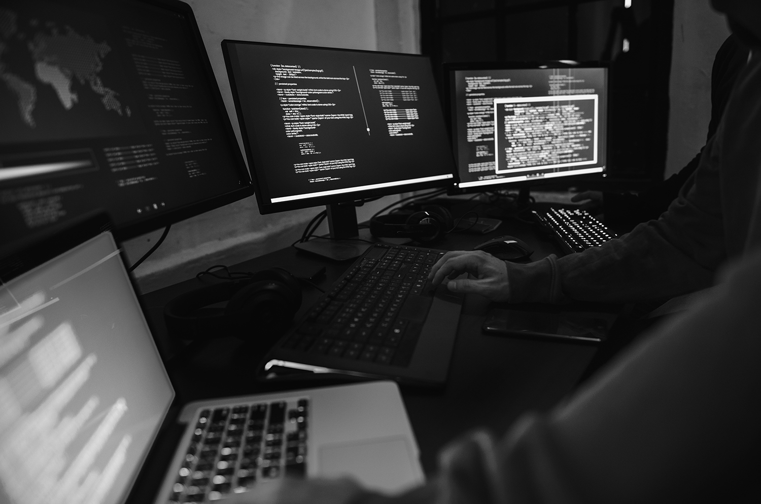

Threat Intelligence, Detection and Automatic Response Integrated with Reverse Engineering.
SUPERVISED BY:
Dr. Yasmine Hosny
T.A Khaled Ayman
PRESENTED BY:
Ahmed Abo Skera, Ahmed Magdy, Seif Elmasry and Mohamed Tamim

Slide 2



Problem Statement
Objectives
Research Questions
Research Data Extraction
Proposed Solution Overview
Evaluation & Metrics
Positioning & Expected Contributions
Conclusion
Contents

Slide 3
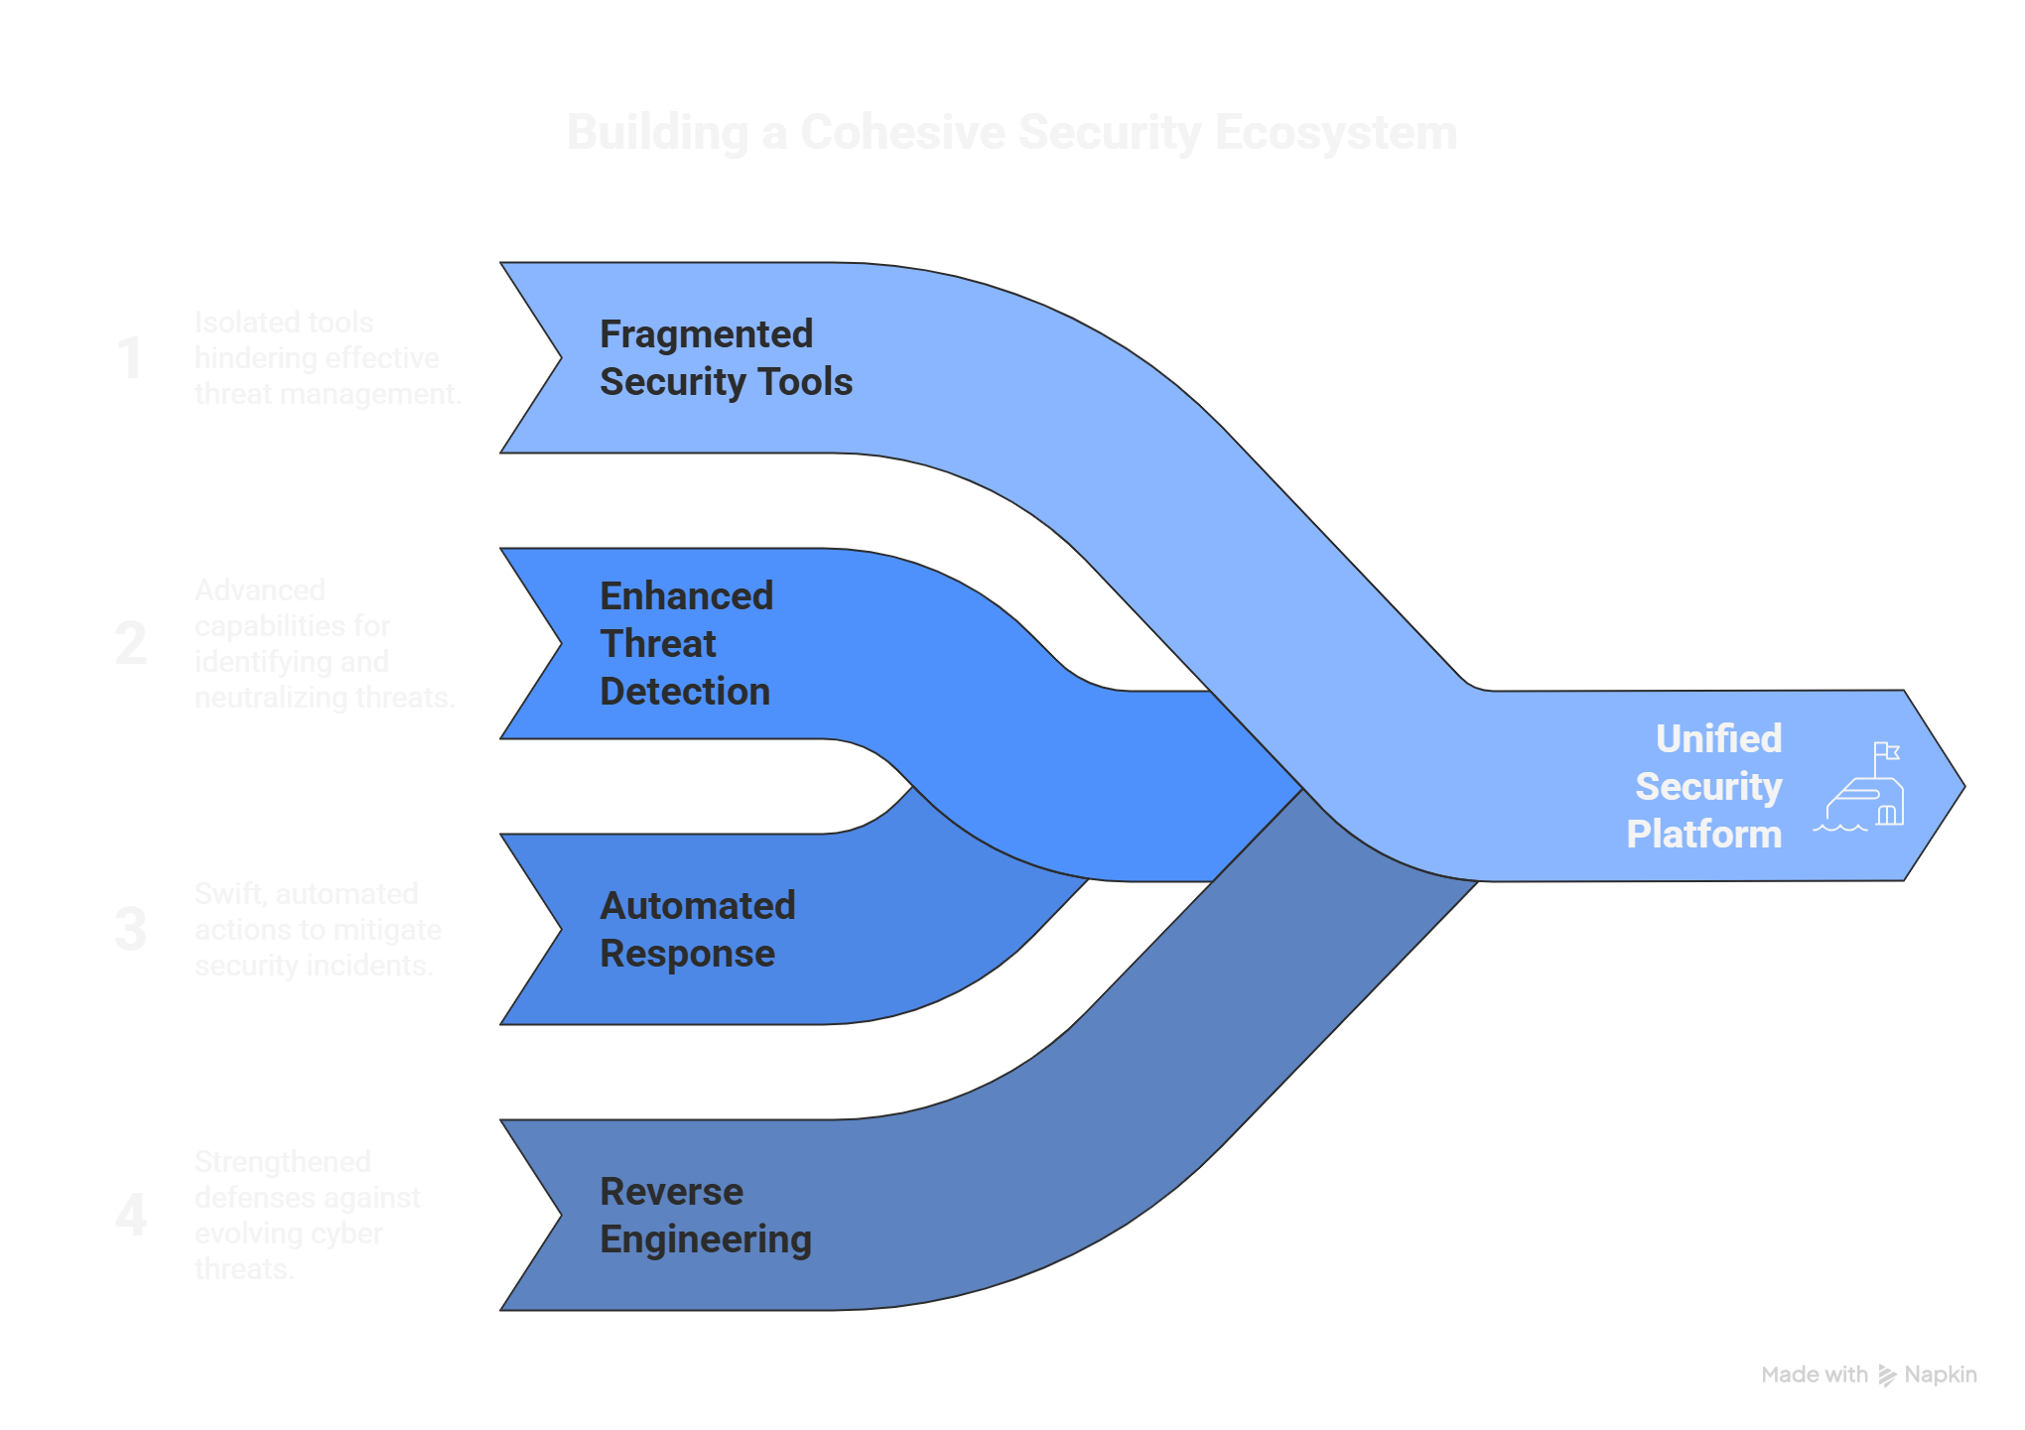
Motivation & Context
01/10
REASONS OF TDARE

Slide 4
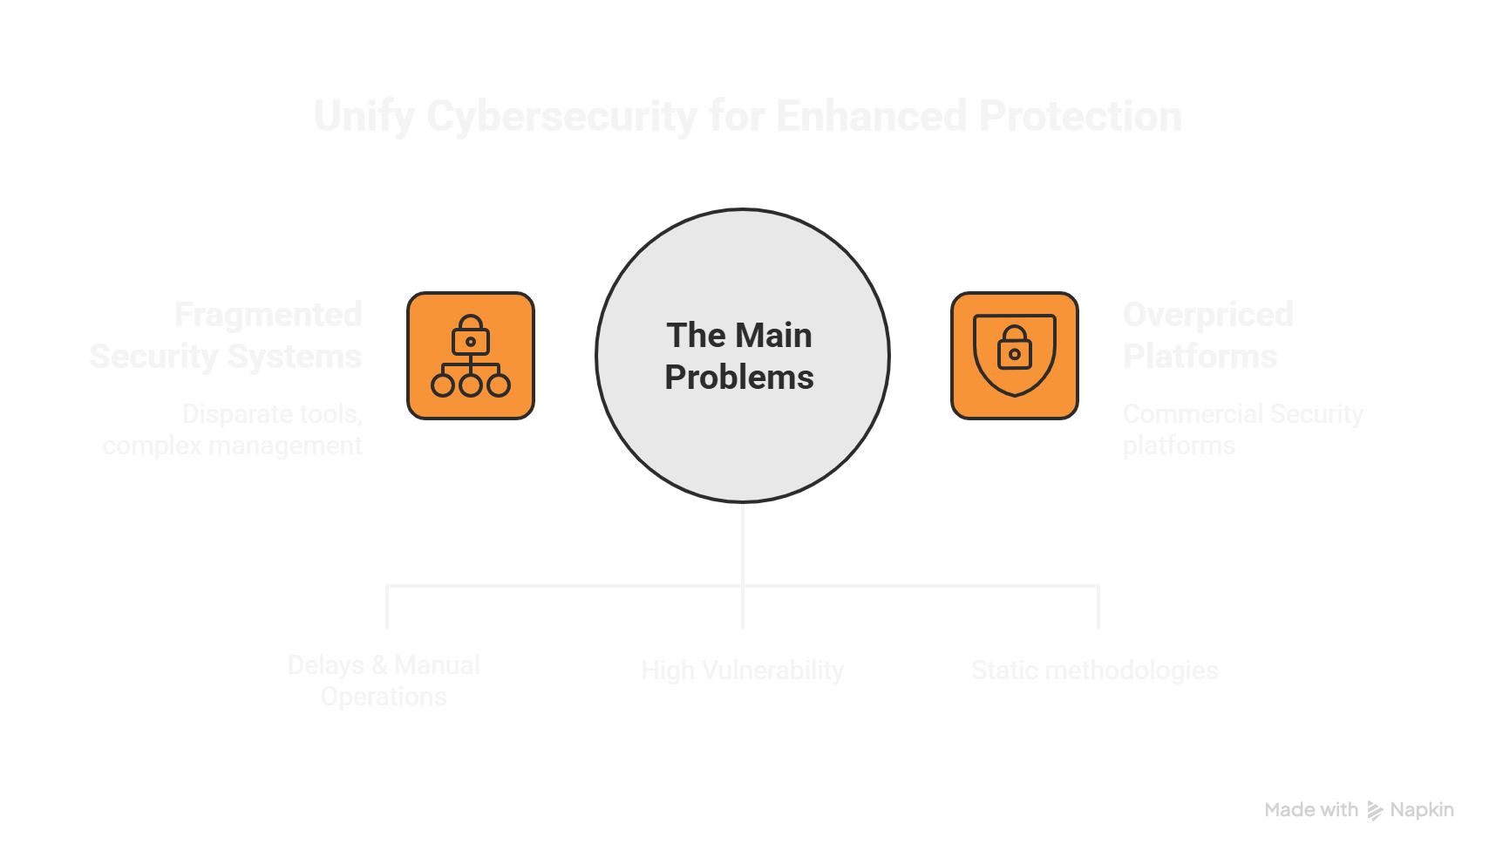

Problem Statements
02/10
THE ROOT CAUSE

Slide 5
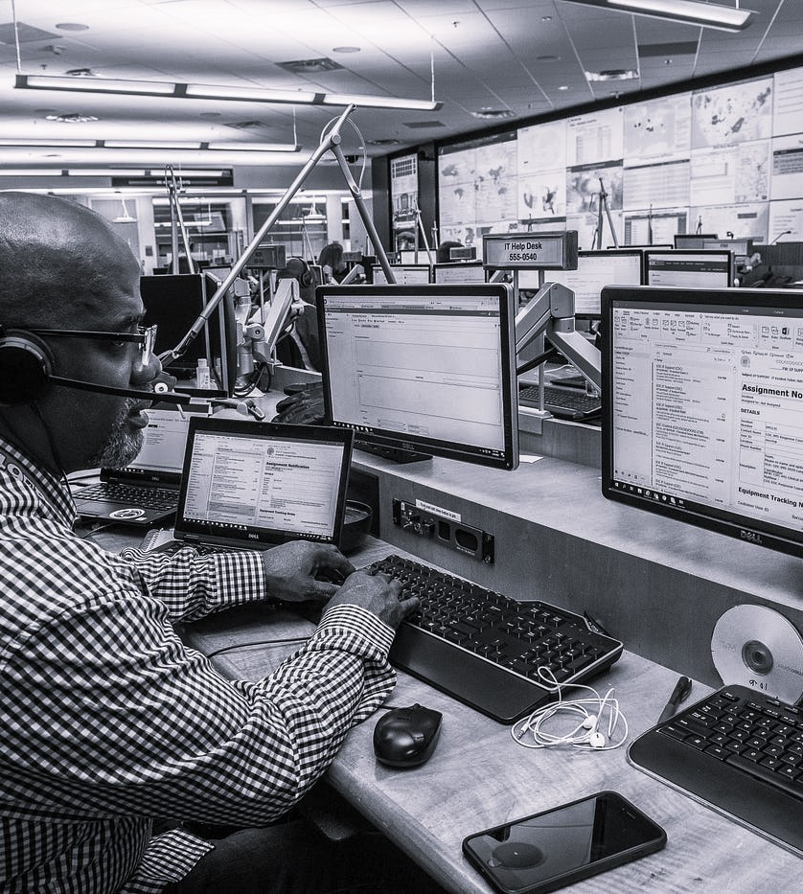
Delays & Manual Operations
Fragmentation
Security Operation Centers (SOC) rely heavily on many separated interfaces and applications for monitoring, scanning and investigating such as SIEMs, nothing is purely Centralized .
Time is very important factor for SOC, using multiple different interfaces in performing manual operations slows down other important actions.
04/10

Slide 6
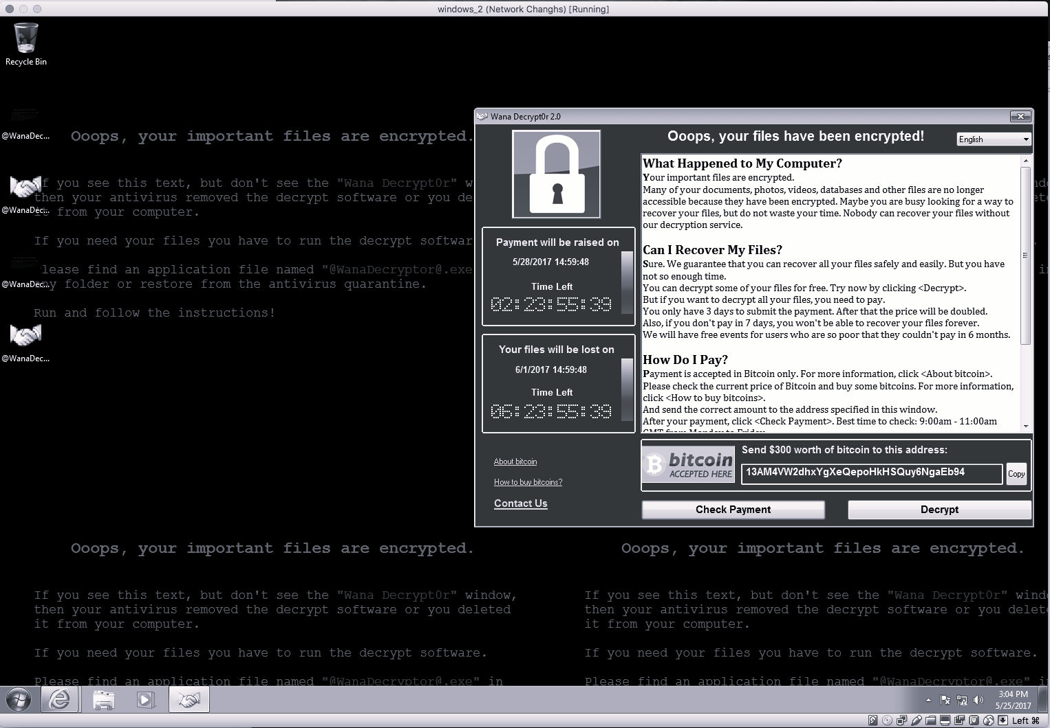
Delays & Manual Operations
Slow Detection
Analysts spend a lot of time while reviewing logs, alerts and scanning, all this causes delays in detection and responding,.
Delaying in detection and responding is critical in cyber security as it leads to fatal impact if the threat did not get mitigated fast.
Ransomware WannaCry: All you need to know
05/10

Slide 7
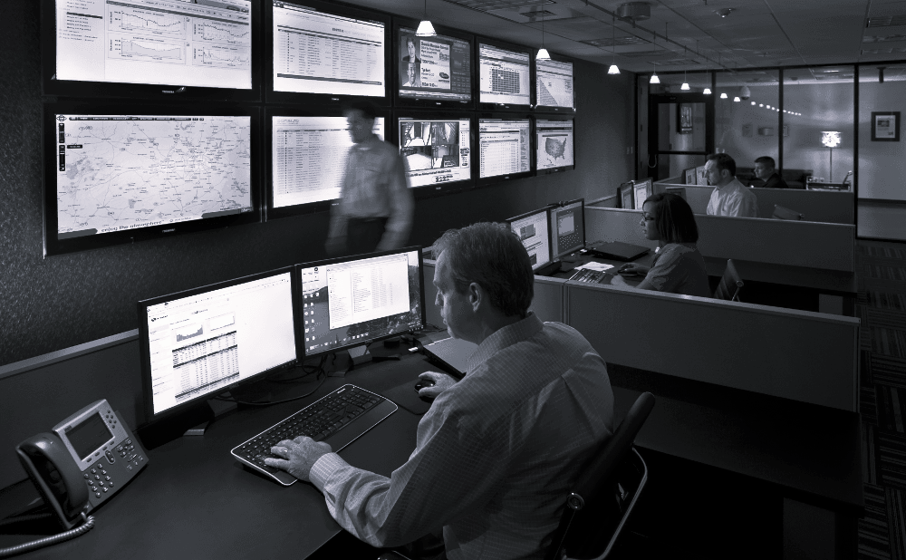
Delays & Manual Operations
Alert Overload
SOC analysts faces huge volume of alerts daily probably most of them are duplicates or false positive, this noise leads to missed critical incidents to respond to all this is draining time and efforts.
SOC analysts face alert overload, duplicate effort, survey finds
06/10

Slide 8
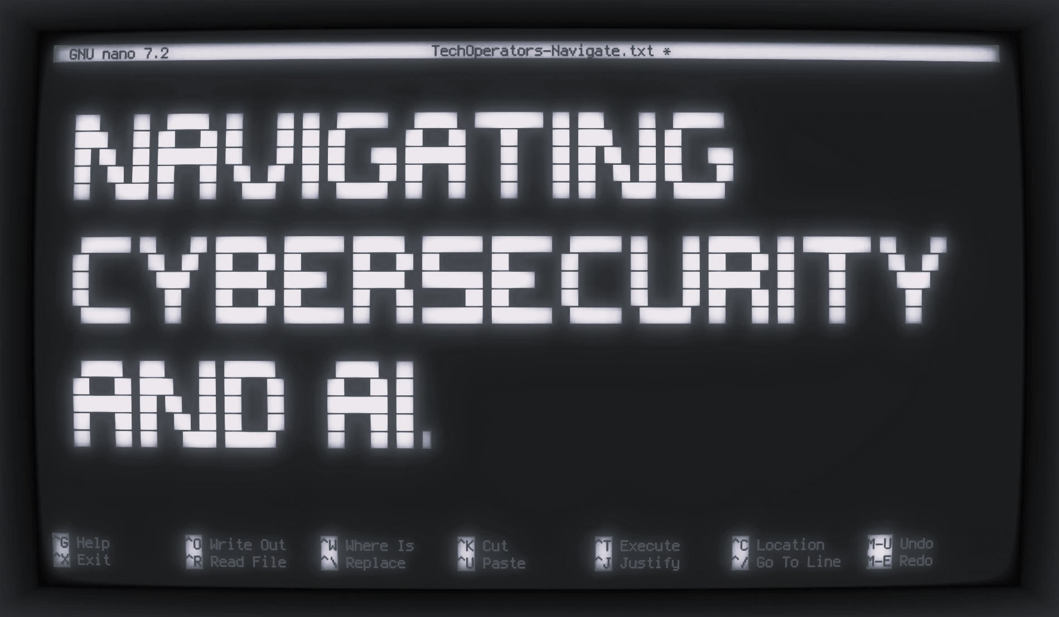
Delays & Manual Operations
Intelligence
SOC analysts use static tools even if it integrates some Artificial Intelligence features, still never going to be as good as full Artificial Intelligence assistant.
Artificial Intelligence (AI) Cybersecurity | IBM
07/10

Slide 9
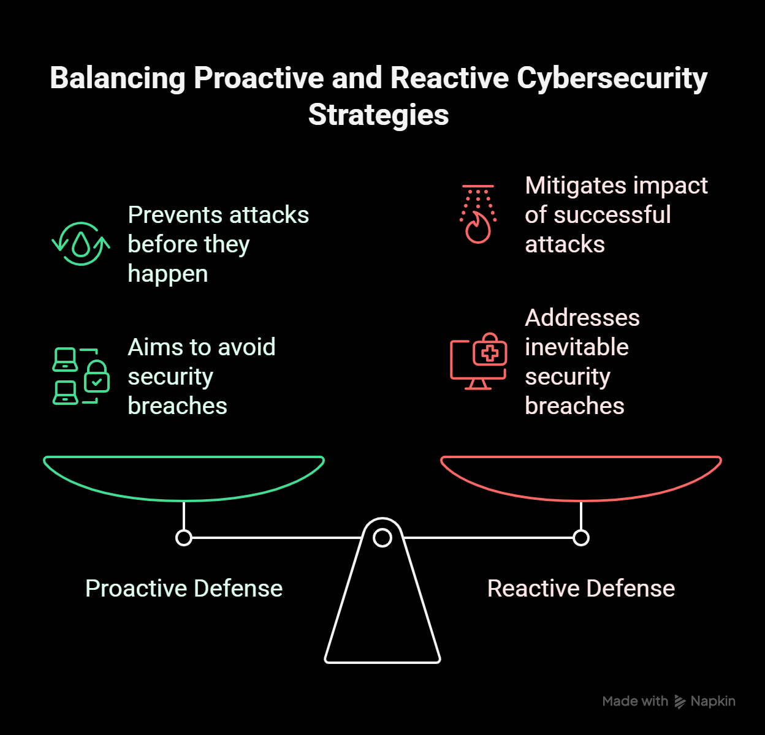
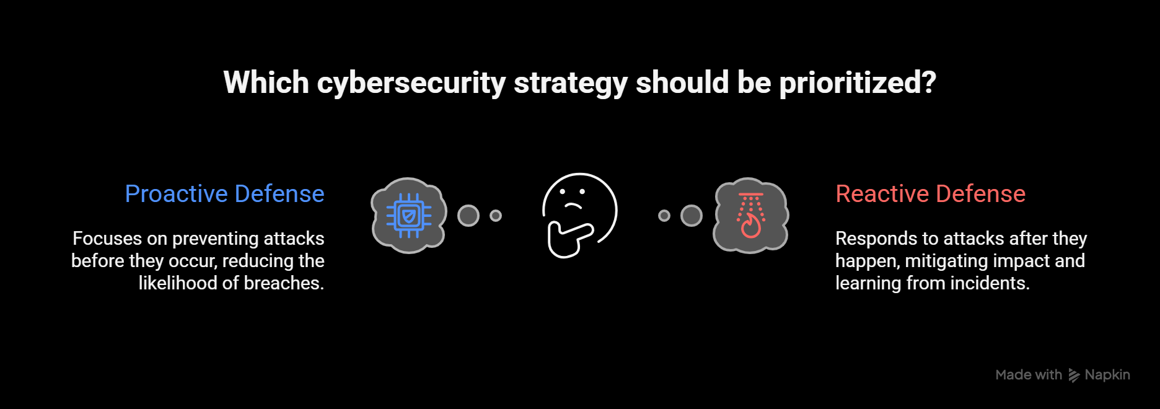
Defensive Mechanism
Reactive Defense
Proactive Defense
Reactive vs. Proactive Cybersecurity: Which Strategy is Best? | Fortinet Blog
08/10

Slide 10
Systemic Inequity
9/10
Global Enterprises
Large Enterprises
Medium Enterprises
Small Business
Startups
Why companies don’t invest in cybersecurity
Hiscox Cyber Readiness Report 2024 | Hiscox Group
How Do Cybersecurity Risks Differ Between Startups and Fortune 500 Companies
IBM Report2024-2025

Slide 11
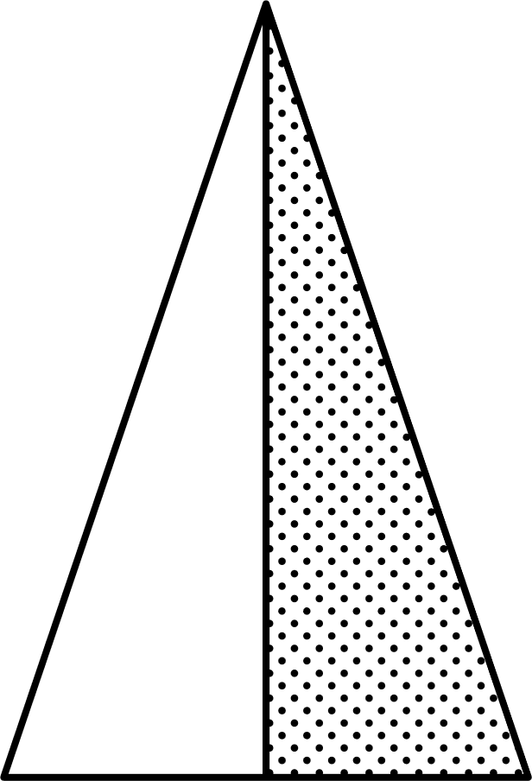

Objectives
10/10
WHAT TDARE TRIES TO ACCOMPLISH
1st
2nd
3rd
4th
Provide SOC with more centralized security platform.
Provide SOC with more automated functionalities with AI.
Apply Proactive defense strategies
Assist SOC to mitigate repeated alerts and find customized solution if brand-new.

Slide 12
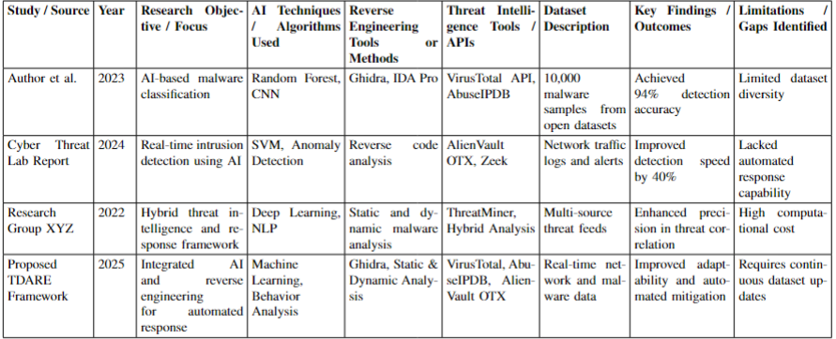
Research Question
11/10
Q\A - 1

Slide 13
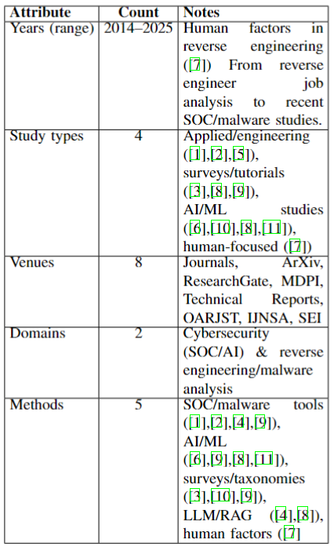
Research Question
13/10
Q\A

Slide 14
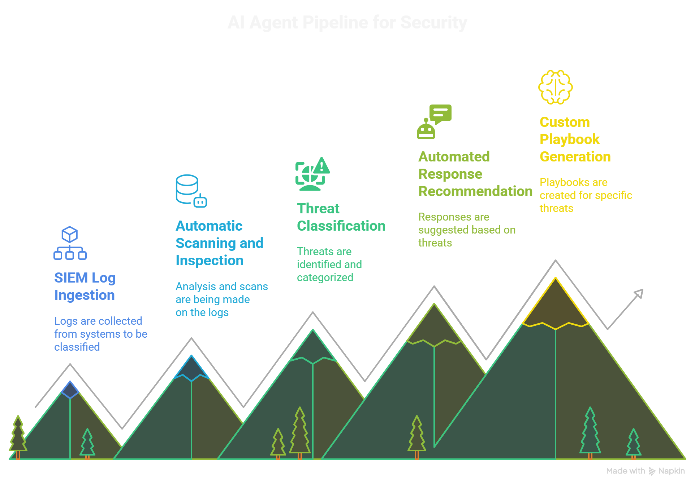
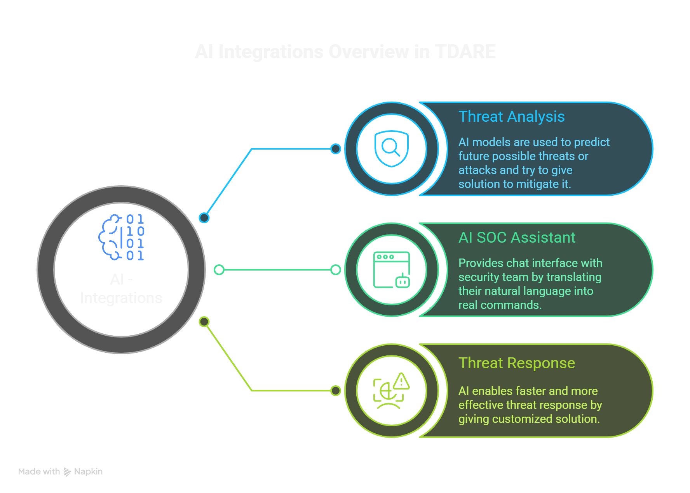
Research Question
12/10
Q\A - 2
Purpose
AI Techniques
Techniques
Machine / Deep Learning (ML/DL): for anomaly detection, event classification.
To decrease the time wasted on manual operations.
Purpose
Techniques
Natural Language Processing (NLP): for analysis and AI assistant agent.
To increase the intelligence factor, and weaponize SOCs.
Pipelines
Integrations
To create an AI assistant that can understand natural language then translate it into commands.
Log Correlation: grouping related alerts into single incidents.
Predictive Analytics: Anticipate likely attack trends.
To detect malicious behavior and create response faster.

Slide 15
Research Question
13/10
Q\A - 3
Market & Tools
TDARE operates across both open-source and closed-source ecosystems.
Focus is placed on open-source integrations to allow continuous improvement and innovation.
Market Orientation
Designed to become a competitive alternative to high-cost commercial cybersecurity platforms.

Slide 16
Research Question
14/10
Q\A - 4
Reactive Defense
Expenses
Fragmented Tools
Gaps & Biases
Lack of Intelligence
Most SOAR tools use static, rule-based logic.
AI-Driven SIEMs are very expensive.
SOCs rely on multiple, disconnected tools for detection and response.
Fragmented Tools
More focused on static rules.
Lack of Intelligence
No adaptive or dynamic defensive methodology.
Reactive Defense
No adaptive or contextual understanding of threats.
Expenses
Enterprise SOAR and security applications are expensive, excluding startups and smaller SOCs.
No dynamic automated actions which leads to delays and useless overload work.
This fragmentation creates alert overload, and slow decision-making.
Mitigation comes after incidents, no chance for automatic evolution.

Slide 17
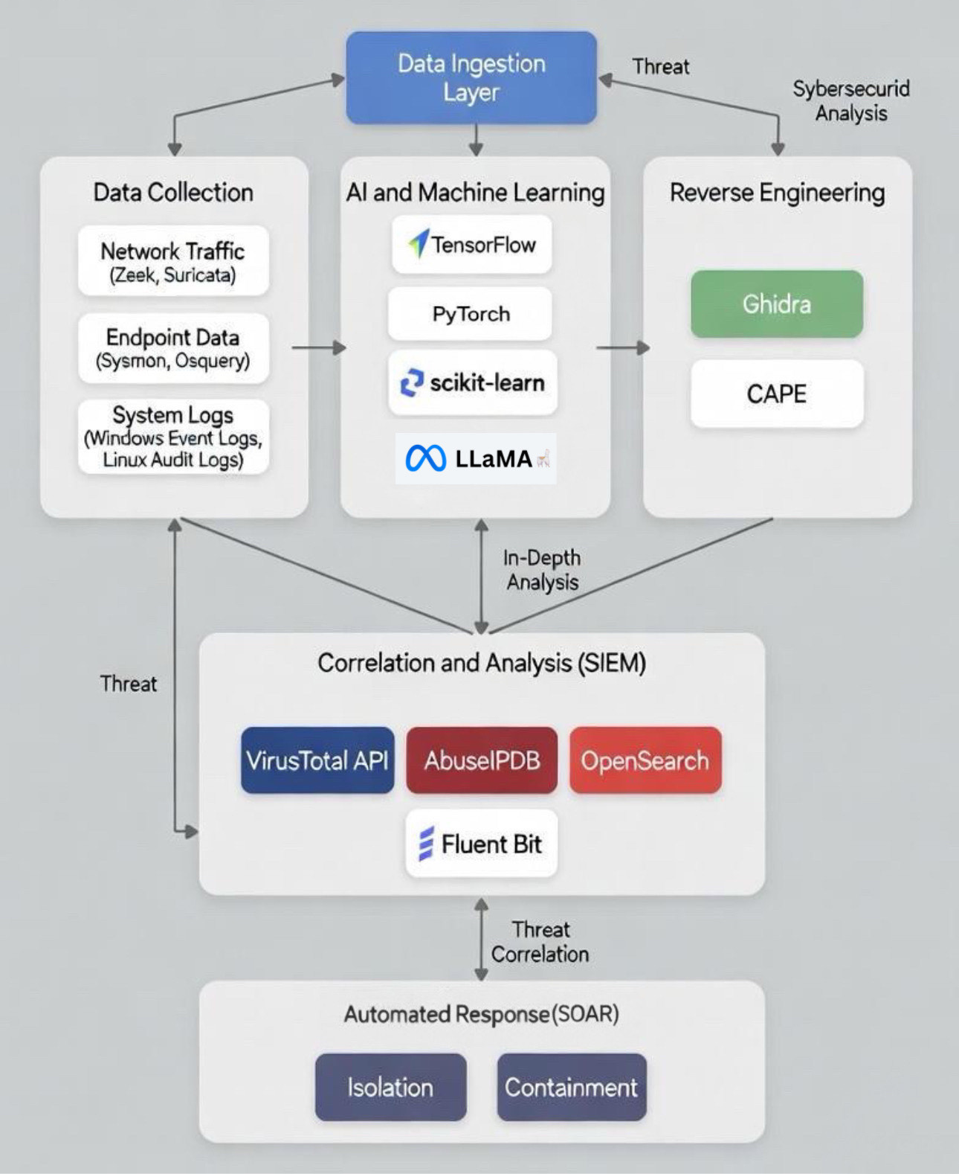
Research Question
16/10
Q\A - 5
Conceptual Framework & Future Opportunities
Integrate more real-time threat feeds and IoT data.
Enhance LLM & Deep Learning models for predictive threat detection and comparison.
Expand automated mitigation for multi-layered security.
Add collaborative features for shared threat intelligence across teams.
Core Components
Future Opportunities
Impact
Improves situational awareness
Accelerates response
Reduces operational overhead in cybersecurity operations.

Slide 18
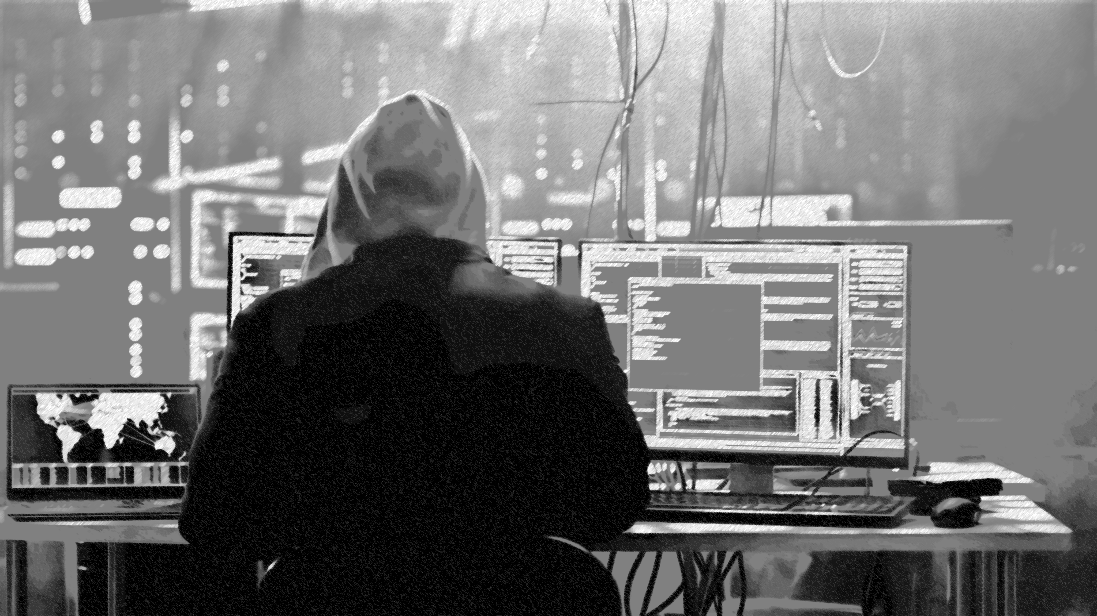
17/10
PROPOSED SOLUTION
The proposed solution part is about implementing each component and its interconnection processes in addition to how TDARE is structured and organized.

Slide 19
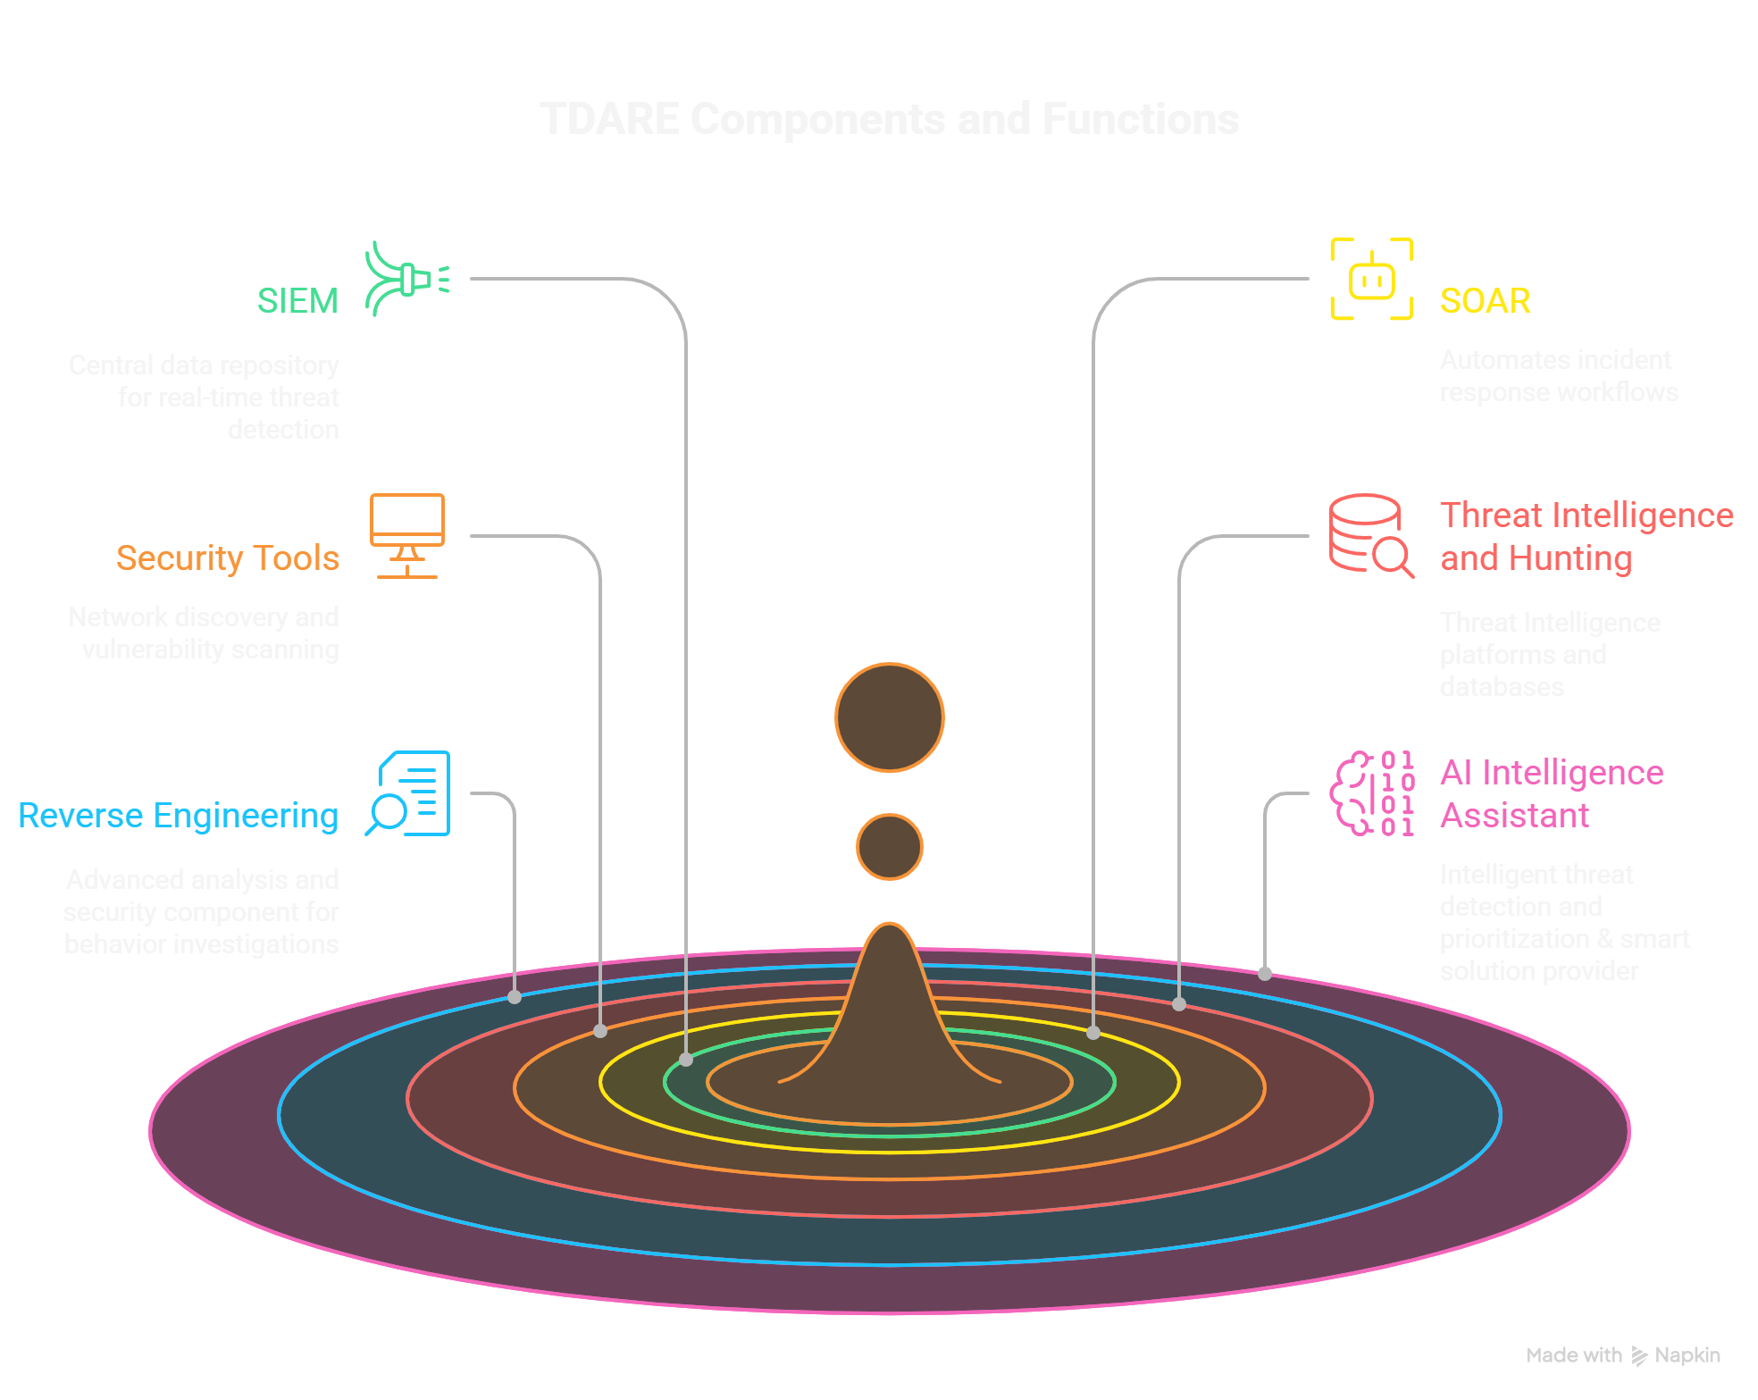
18/10
Let’s Dive Into TDARE

Slide 20
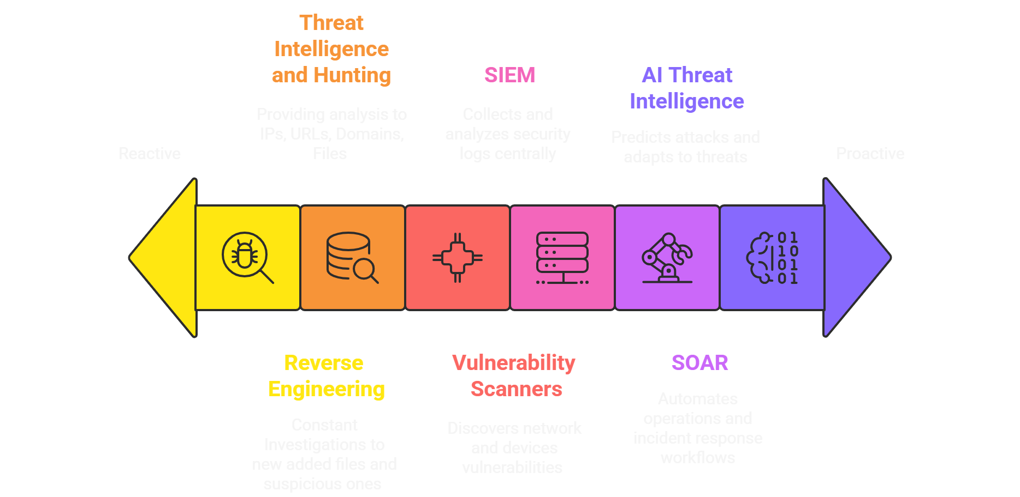
Contributions of TDARE Components
19/10

Slide 21
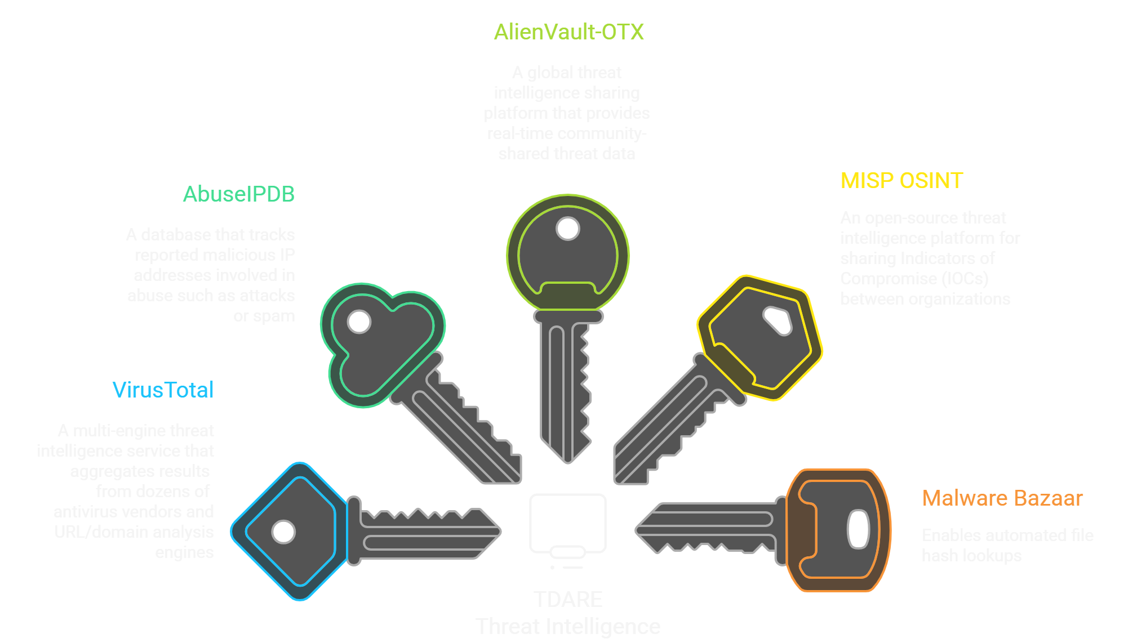
Threat Intelligence Integrations
19/10

Slide 22
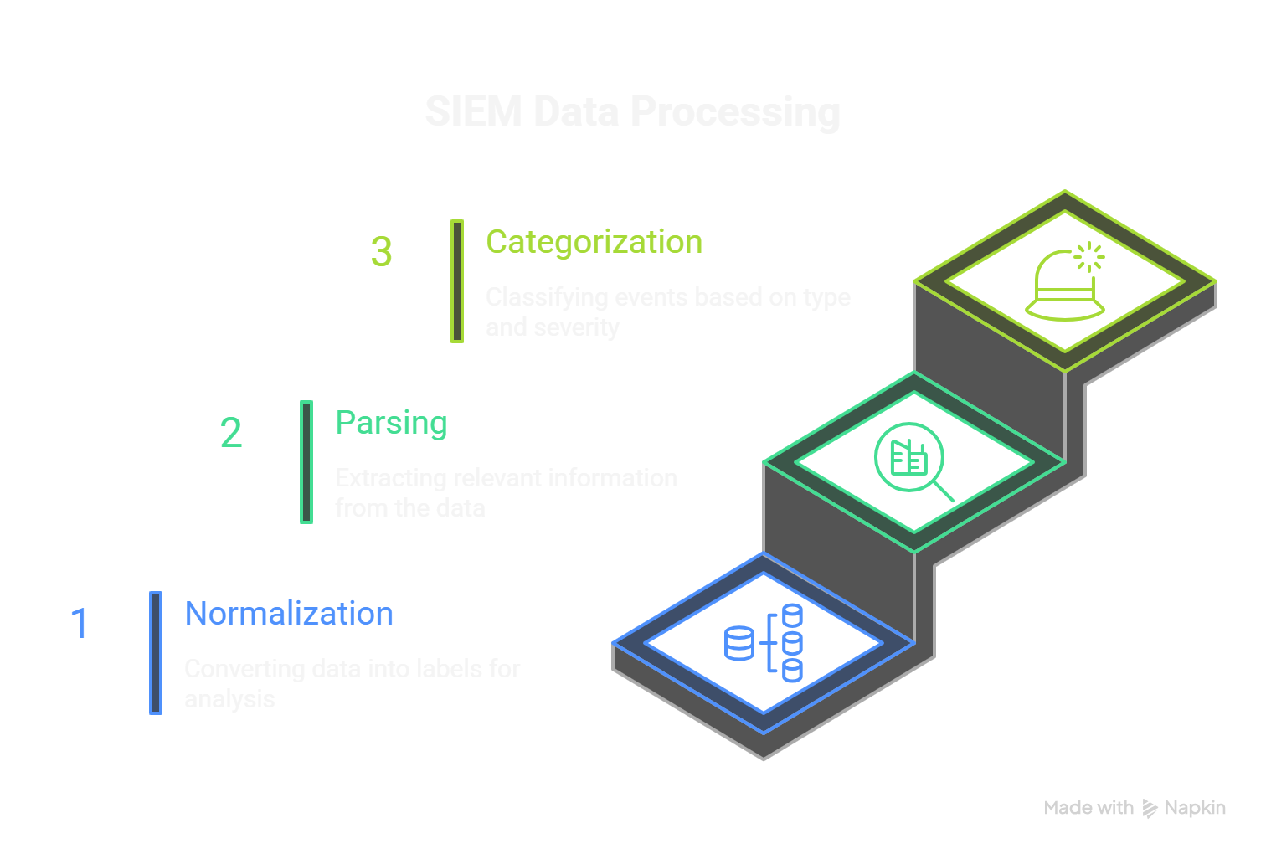
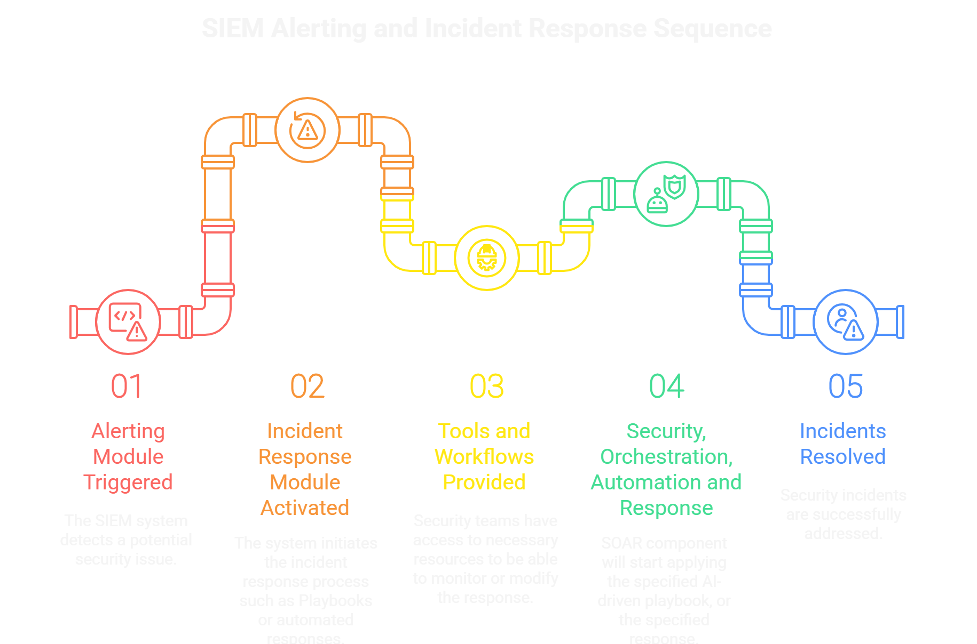
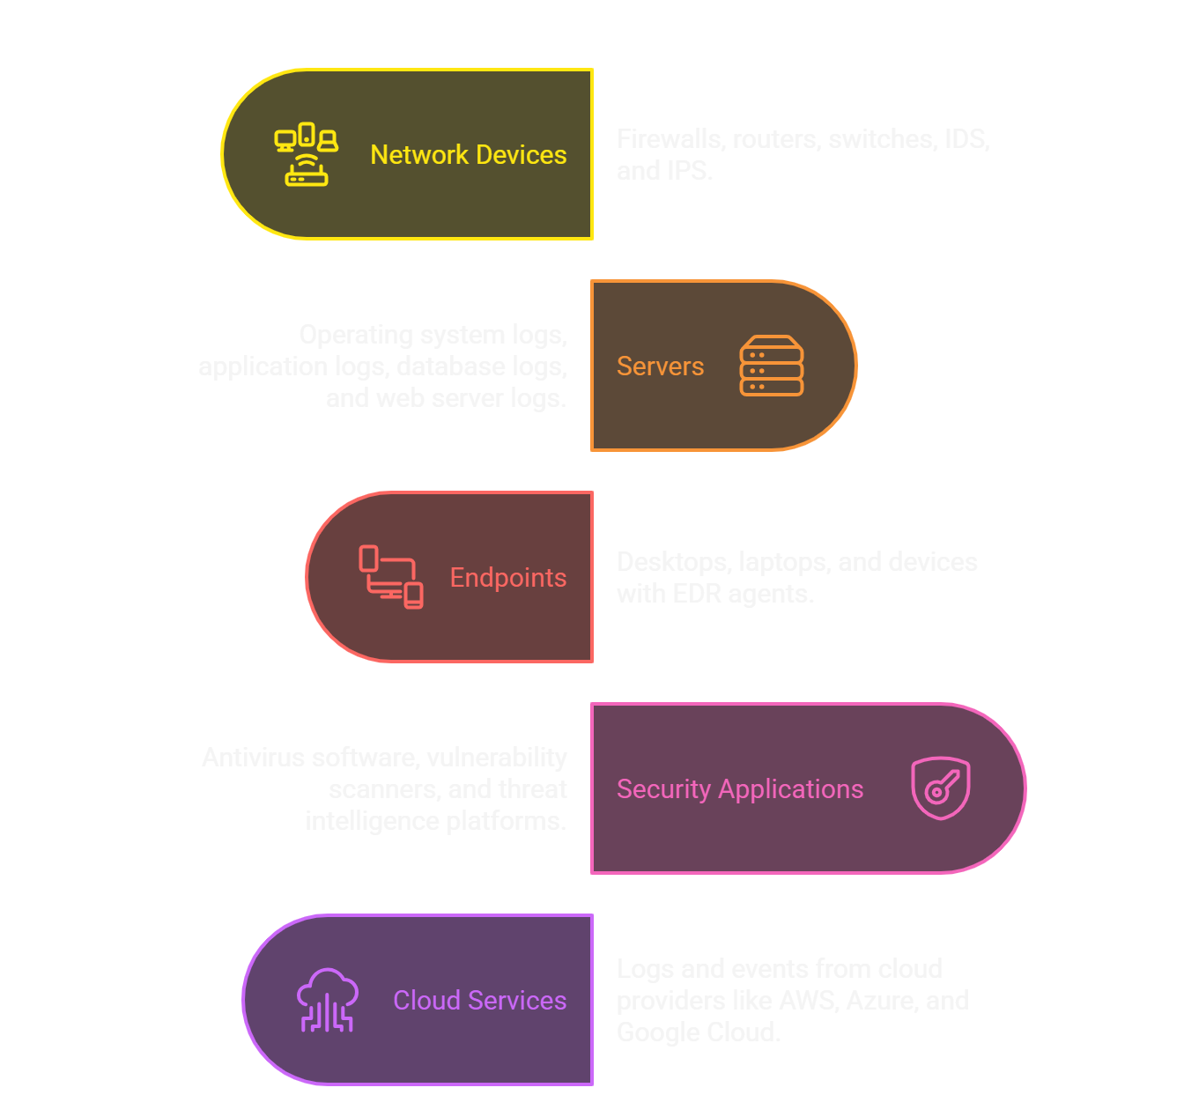
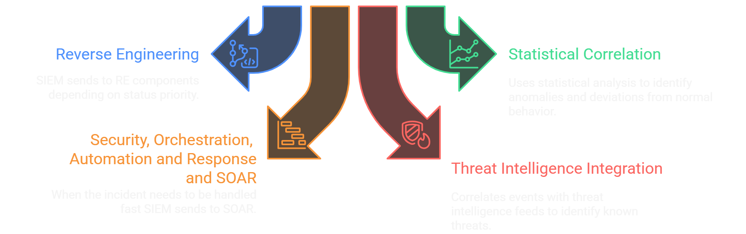
SIEM Data collection
SIEM Data Flow
19/10

Slide 23
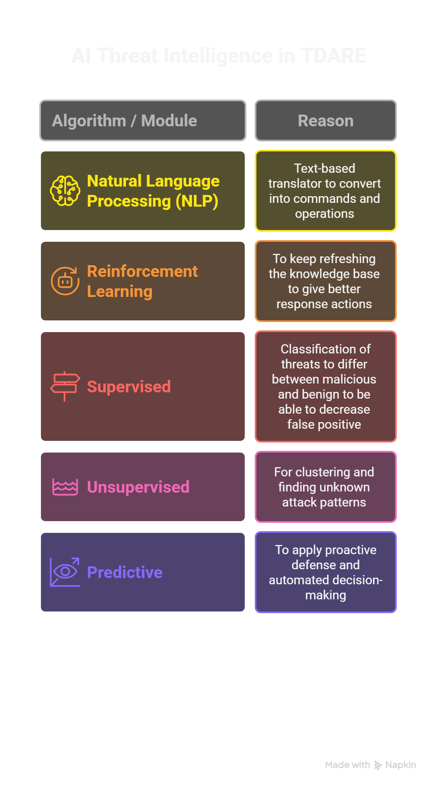
19/10

Slide 24
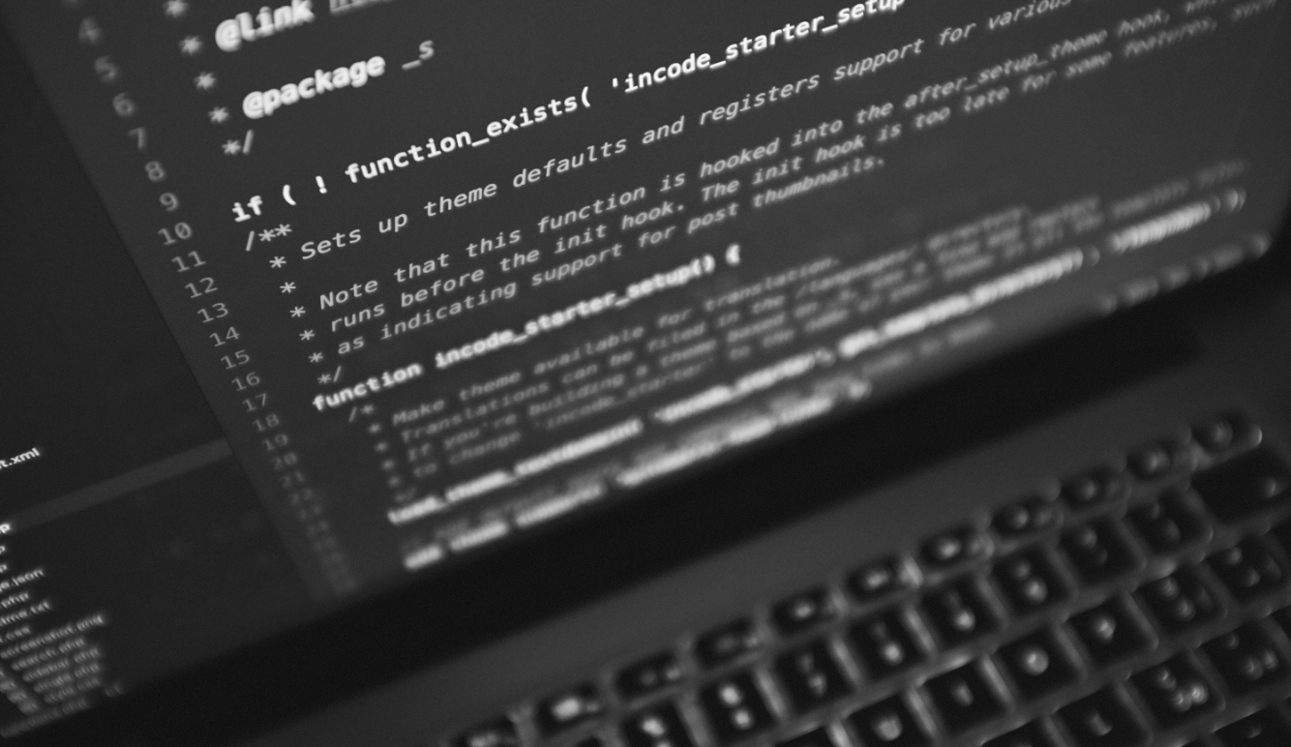
19/10
WHAT IS REVERSE ENGINEERING

Slide 25
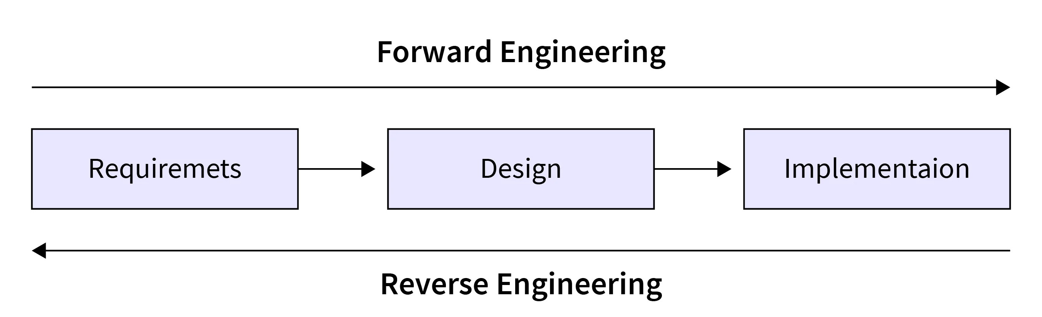
19/10
REVERSE ENGINEERING
Reverse Engineering (RE) is the process of analyzing software, hardware, or systems to understand how they work — often without access to the original source code.
It’s used to discover structure, behavior, and logic behind programs.

Slide 26

19/10
REVERSE ENGINEERING

Slide 27

19/10
REVERSE ENGINEERING

Slide 28
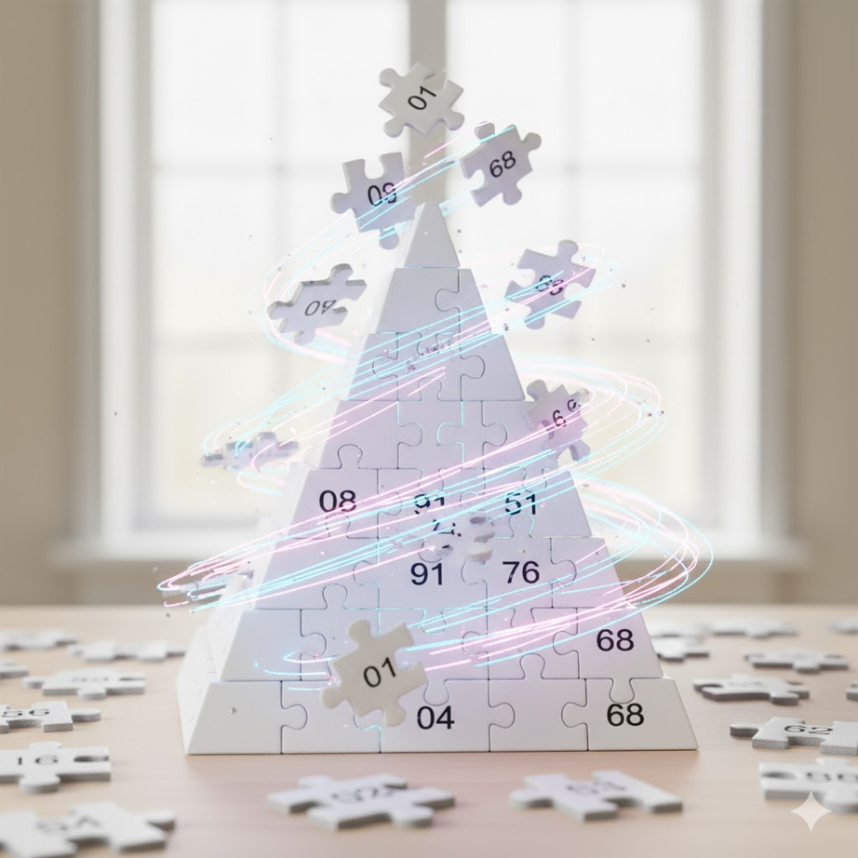
19/10
REVERSE ENGINEERING

Slide 29
19/10
REVERSE ENGINEERING
INTEGRATION INTO CYBERSECURITY (2000S – PRESENT)
BECAME ESSENTIAL FOR MALWARE ANALYSIS AND VULNERABILITY RESEARCH USED IN:
1- MALWARE AND VIRUS ANALYSIS.
2- DIGITAL FORENSICS.
3- PENETRATION TESTING.
4- THREAT INTELLIGENCE.
5- EXPLOIT DEVELOPMENT AND PATCH ANALYSIS
EARLY HISTORY (1940S – 1970S)
BEGAN IN MECHANICAL AND MILITARY ENGINEERING and USED TO STUDY CAPTURED ENEMY TECHNOLOGY — LIKE AIRCRAFT, WEAPONS, AND COMMUNICATION SYSTEMS.
LATER MOVED TO ELECTRONICS FOR ANALYZING CIRCUITS AND MICROCHIPS.
SOFTWARE REVOLUTION (1980S – 1990S)
REVERSE ENGINEERING SHIFTED TO SOFTWARE WITH THE RISE OF PERSONAL COMPUTERS USED TO:
1- UNDERSTAND PROGRAMS WITHOUT SOURCE CODE.
2- BYPASS SOFTWARE PROTECTIONS (CRACKING, LICENSE REMOVAL).
3- ANALYZE VIRUSES AND MALWARE.
4- EARLY TOOLS: DISASSEMBLERS, HEX EDITORS, AND DEBUGGERS.
CYBERSECURITY TEAMS BEGAN USING RE TO ANALYZE MALWARE AND UNDERSTAND CYBERATTACKS,
ANTIVIRUS AND THREAT INTELLIGENCE COMPANIES STARTED HIRING REVERSE ENGINEERS From 201S – TODAY

Slide 30
19/10
WHY DO WE USE REVERSE ENGINEERING
To understand old or undocumented software
To study malware and how it attacks systems
To find and fix vulnerabilities
To perform digital forensics
To improve security defenses

Slide 31
19/10
REVERSE ENGINEERING
Static Analysis (Without Running the Program)
We analyze the file or code without executing it.
Dynamic Analysis (By Running and Observing)
We run the program in a sandbox or controlled environment to watch its behavior

Slide 32
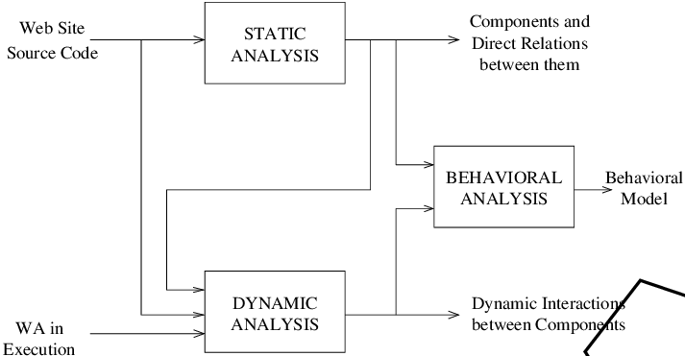
REVERSE ENGINEERING
19/10

Slide 33
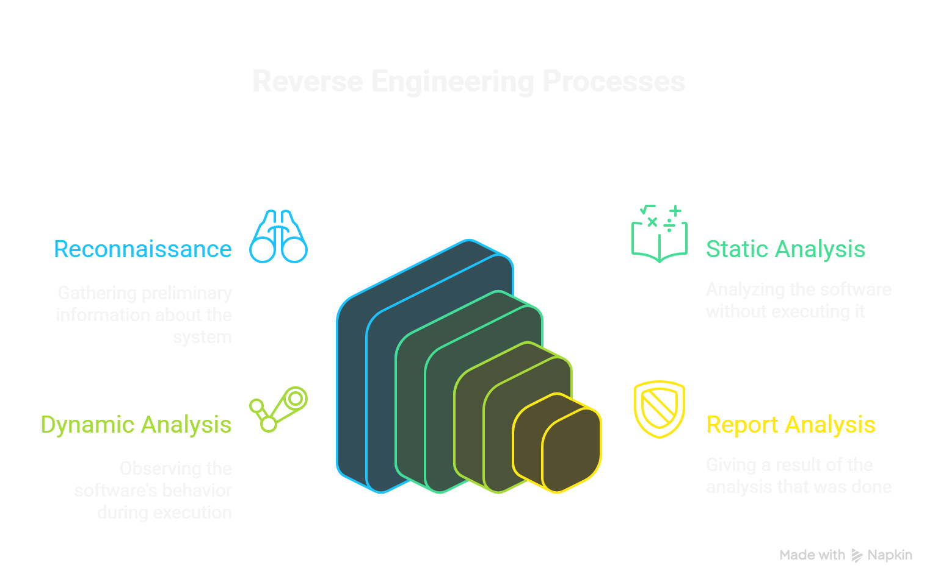
19/10
REVERSE ENGINEERING

Slide 34
STATIC ANALYSIS
19/10
TOOLS
GHIDRA
IDA PRO
RADARE2
BINARY NINJA
HEX EDITORS (HXD, 010 EDITOR)
`

Slide 35
19/10
DYNAMIC ANALYSIS
TOOLS
CAPE Sandbox
OllyDbg
Process Monitor (ProcMon)
Cuckoo Sandbox
WE RUN THE PROGRAM IN A SANDBOX OR CONTROLLED ENVIRONMENT TO WATCH ITS BEHAVIOR.

Slide 36
19/10
REVERSE ENGINEERING IN TDARE
AUTOMATICALLY SEND SUSPICIOUS SAMPLES TO RE TOOLS
COMBINE STATIC & DYNAMIC ANALYSIS
STORE STRUCTURED REPORTS FOR FAST RESPONSE

Slide 37
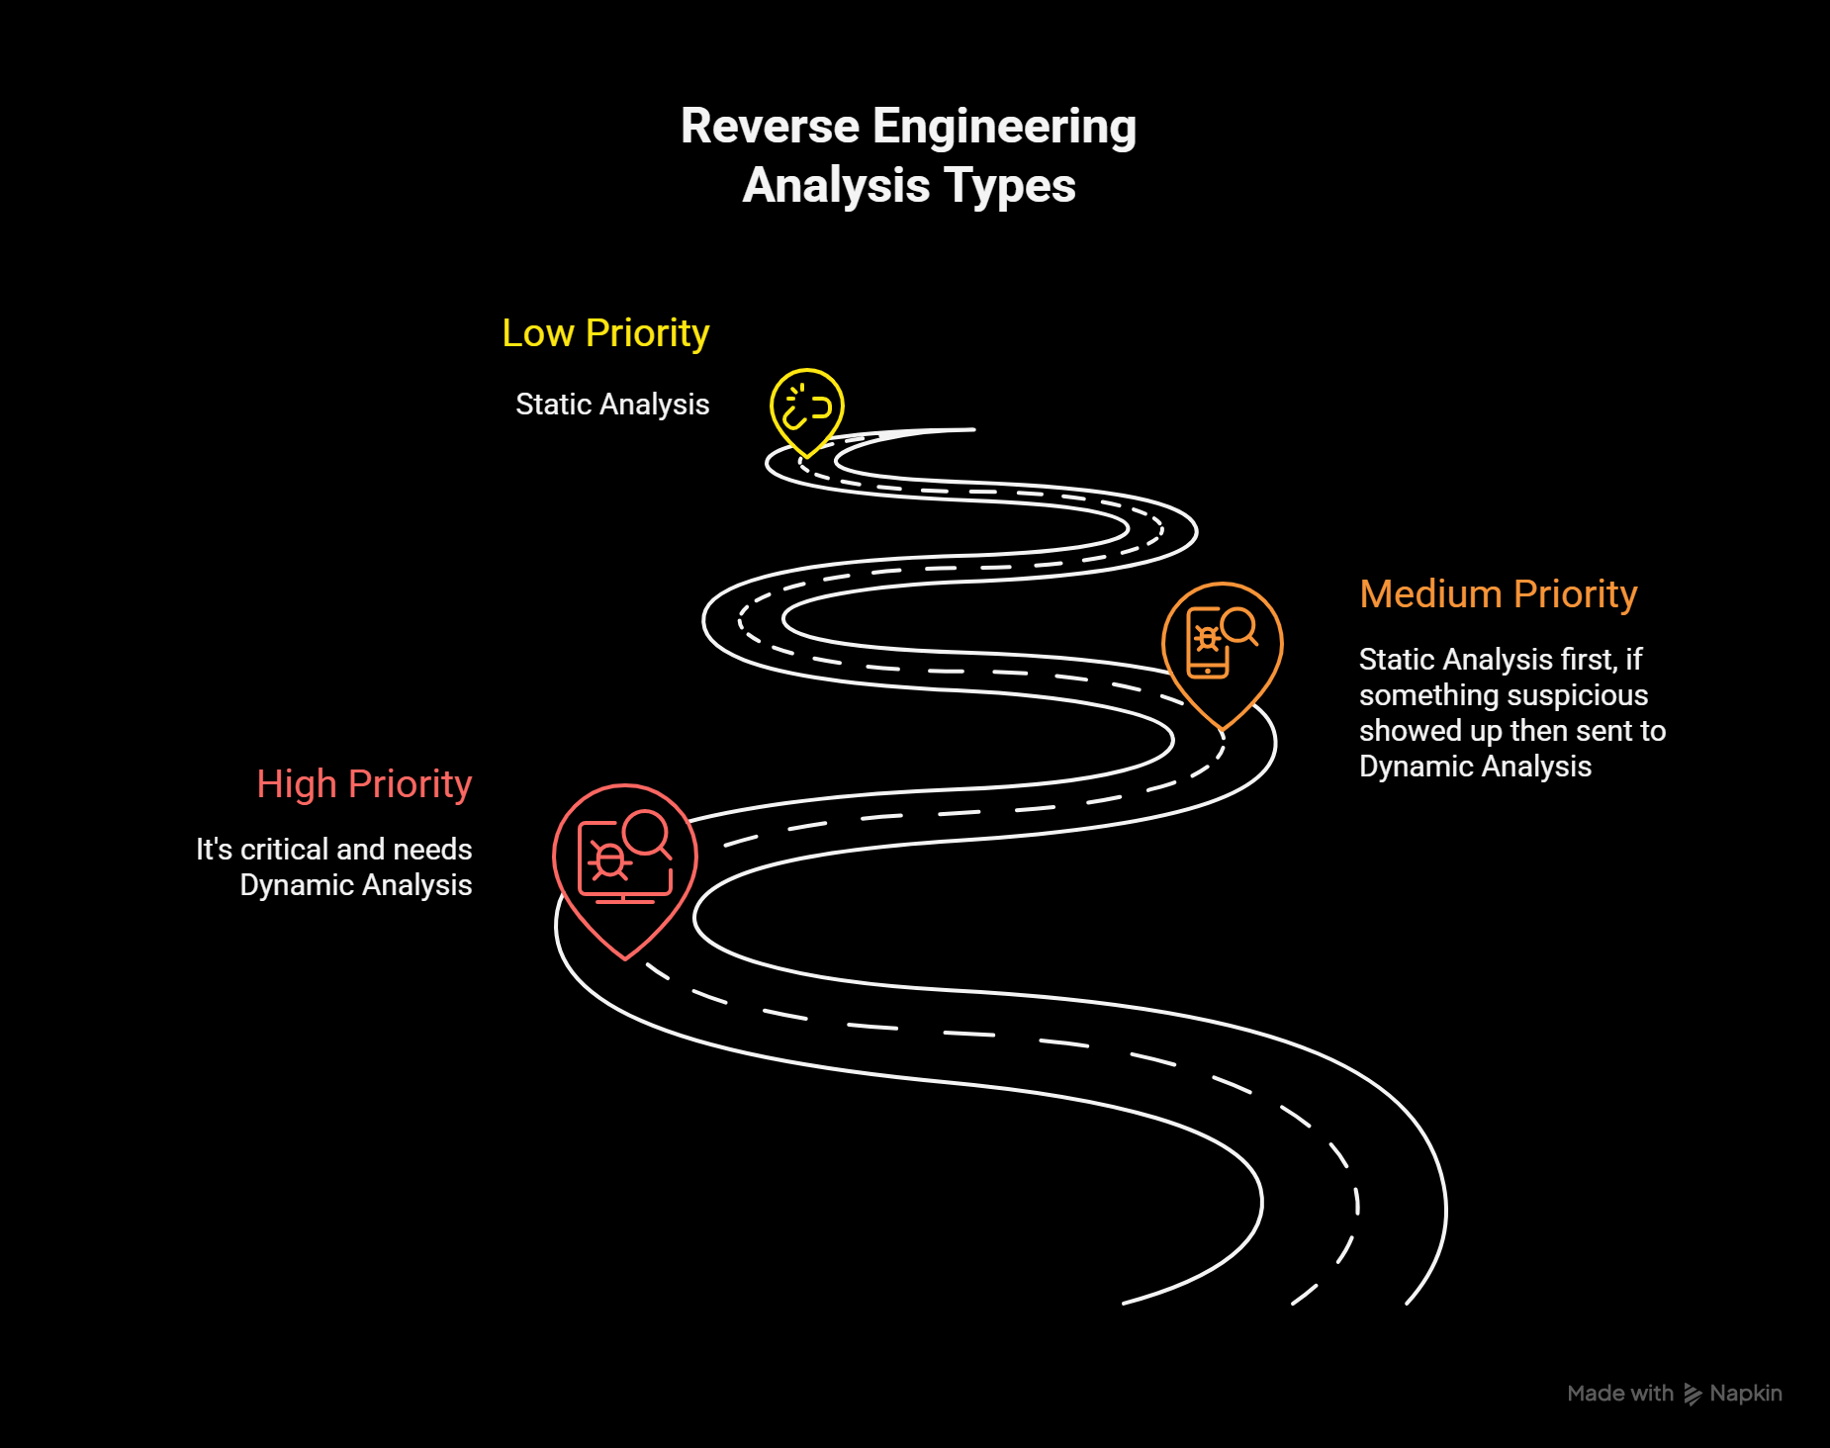
WHEN TO SEND FILE TO REVERSE ENGINEERING
19/10

Slide 38
HIGH‑PRIORITY-TRIGGERS
19/10
Executable Files with Unusual Locations
Examples: .exe, .dll, .bin, .ps1, .py appearing in temp or user folders.
Files with known bad hashes
If sha256/md5 appears and matches VT/Vendor feeds / internal
blocklist → send.
3.Files dropped by suspicious processes
Parent process is scriptable tool (e.g., powershell.exe, cmd.exe,
python.exe, wmic.exe) spawning rundll32, regsvr32

Slide 39
MEDIUM‑PRIORITY-TRIGGERS
19/10
UNKNOWN FILE TYPES > CERTAIN SIZE (E.G., > 100KB) FROM UNTRUSTED SOURCES.
FILE CREATED BY RARE PROCESSES.

Slide 40
LOW‑PRIORITY-TRIGGERS
19/10
MINOR POLICY VIOLATIONS (NON-EXECUTABLE SCRIPTS IN USER DOC FOLDERS), EXPIRED CERT, NON-CRITICAL ERRORS.
TOOLS RETURN JSON REPORTS TO DB

Slide 41
19/10
USED IN TDARE
DYNAMIC : CAPE
STATIC: GHIDRA

Slide 42
19/10
HOW GHIDRA WORKS (STATIC ANALYSIS)
Ghidra is a static reverse-engineering suite (created by the nsa) that reads a binary file and translates machine code into human-readable assembly and a high-level pseudo-language (decompiled code). You do not run the file in ghidra — you inspect its structure.
HOW CAPE WORKS (DYNAMIC ANALYSIS / SANDBOX)
CAPE is an automated sandbox that runs suspicious files in a controlled virtual machine and records everything they do — processes, files created, registry changes, network traffic, screenshots, and more.

Slide 43
WHY USE BOTH
19/10
STATIC FINDS HIDDEN STRUCTURE
DYNAMIC SHOWS REAL BEHAVIOR

Slide 44
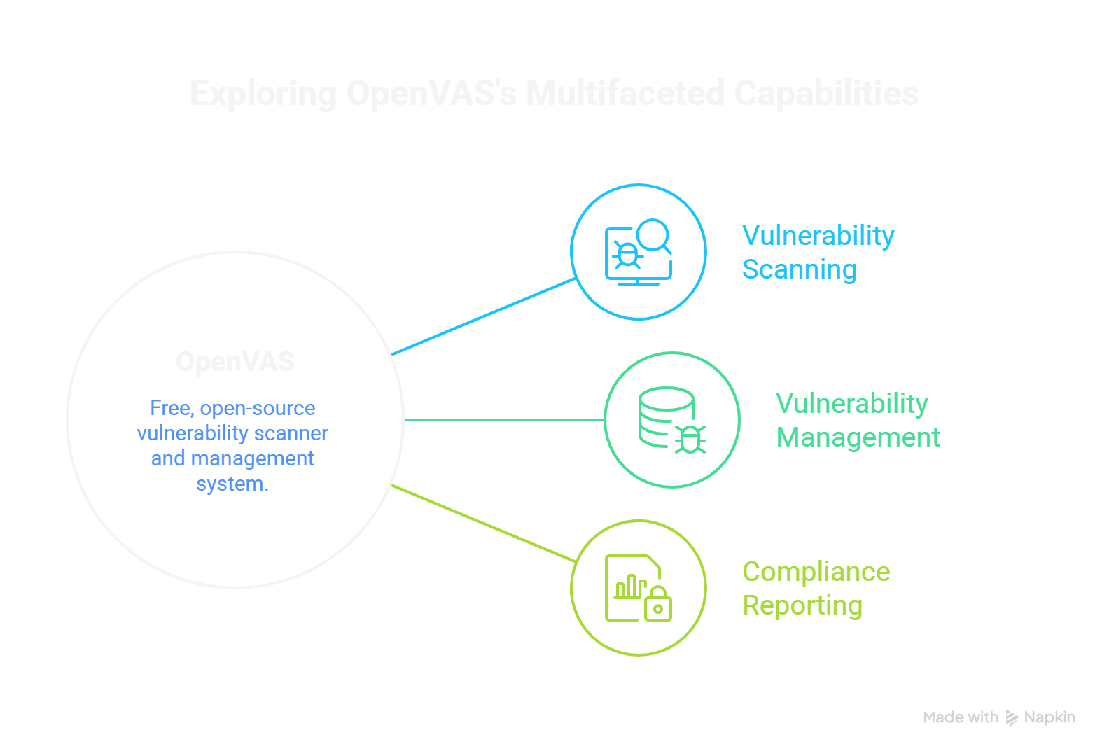
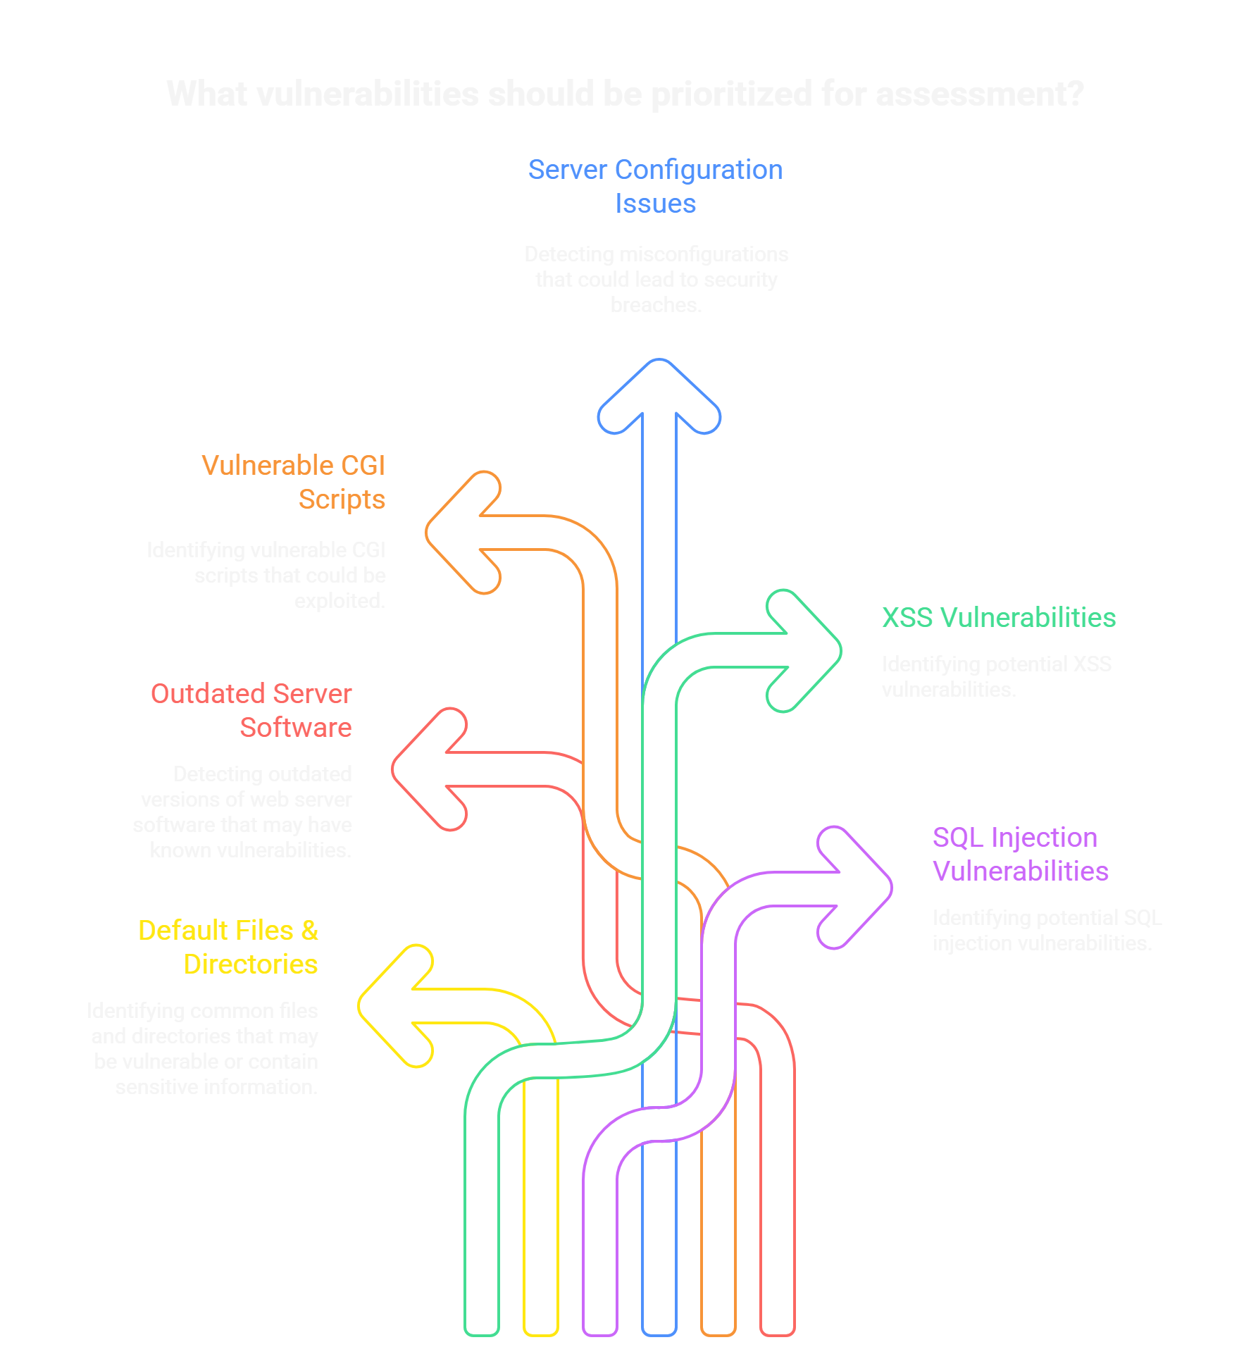
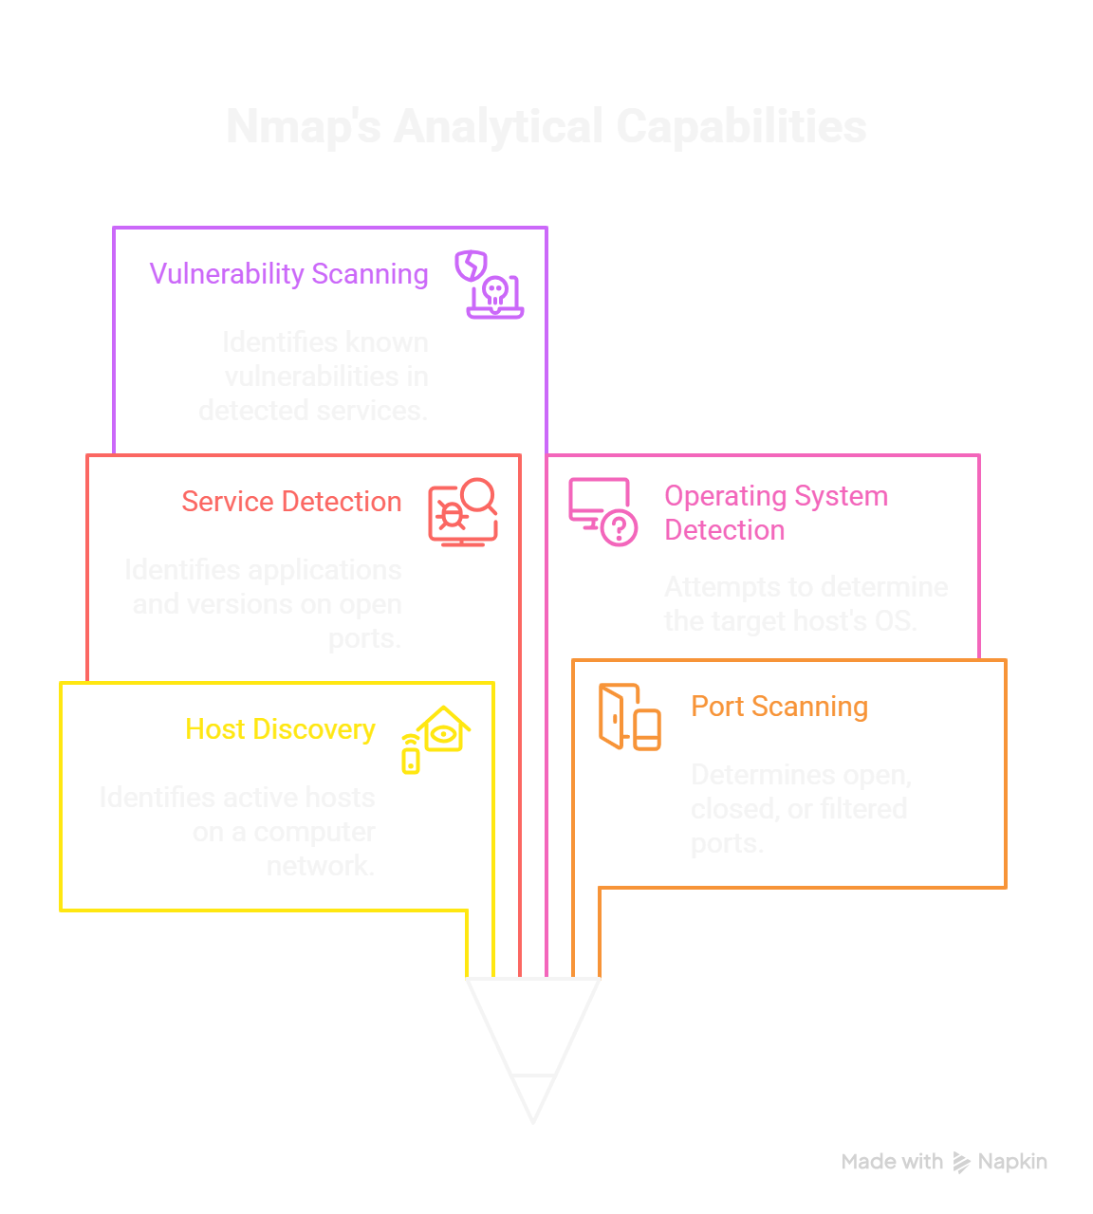
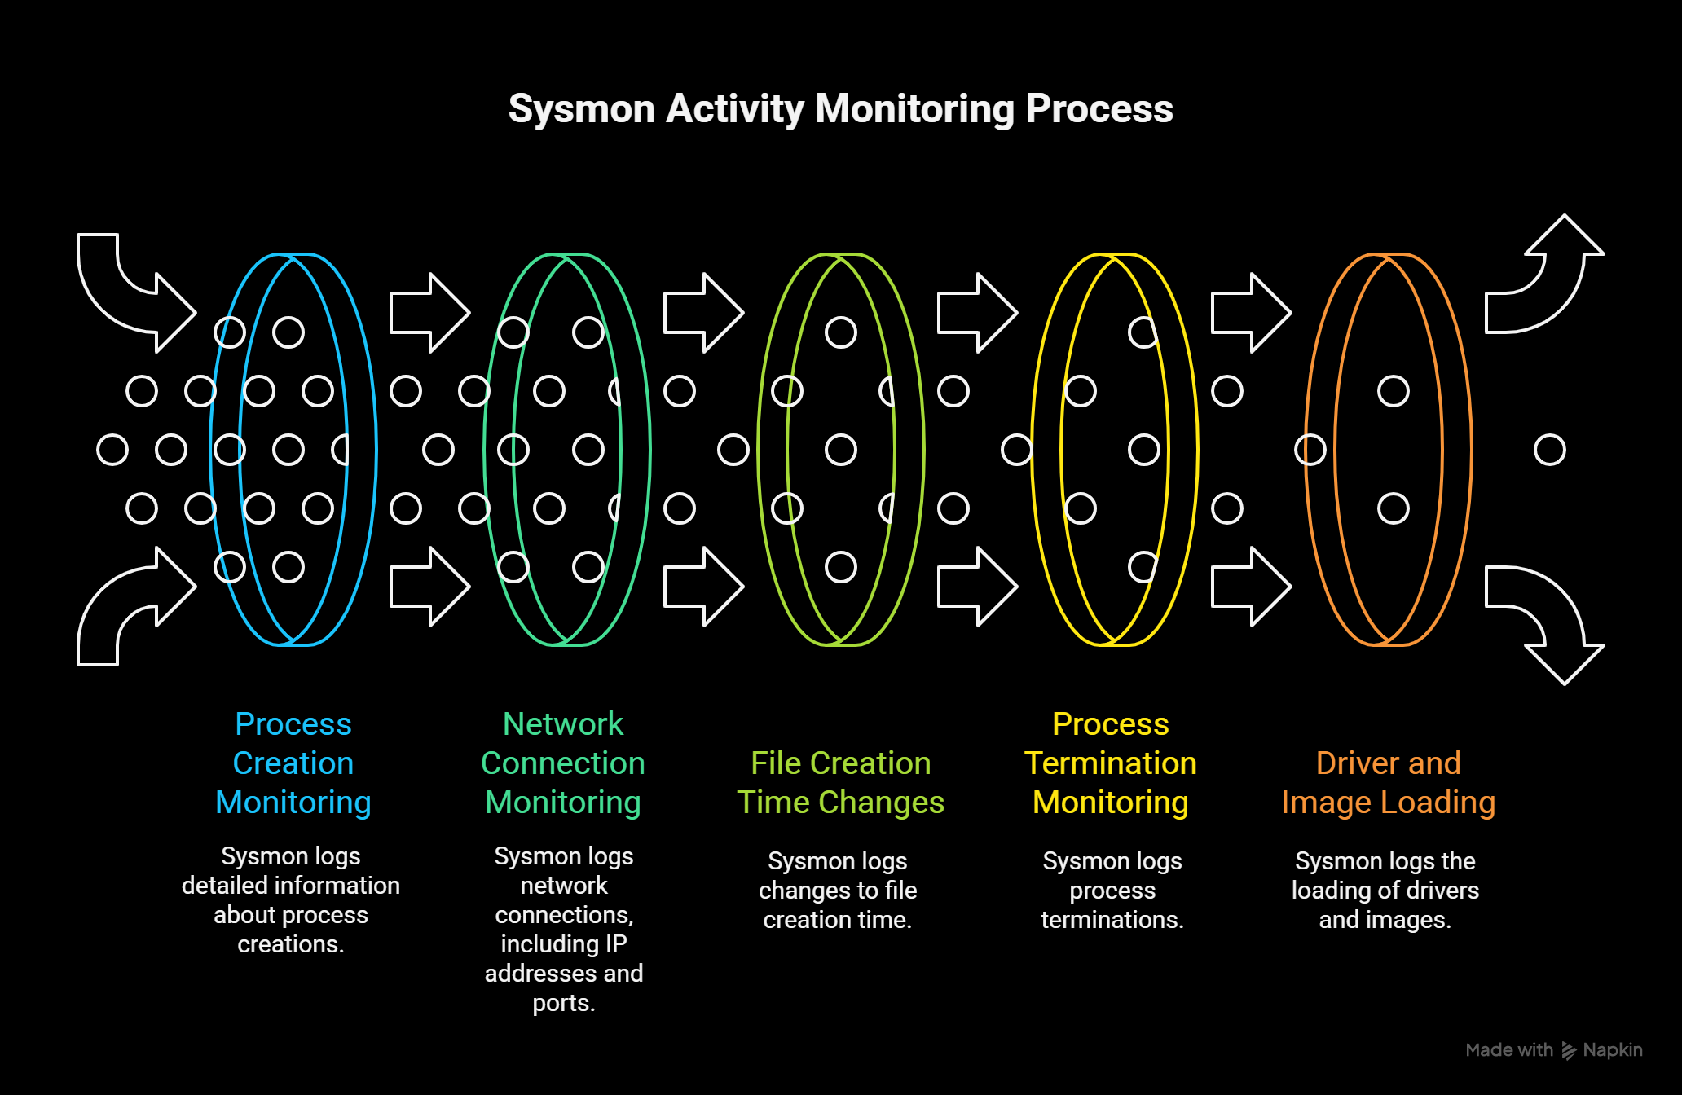
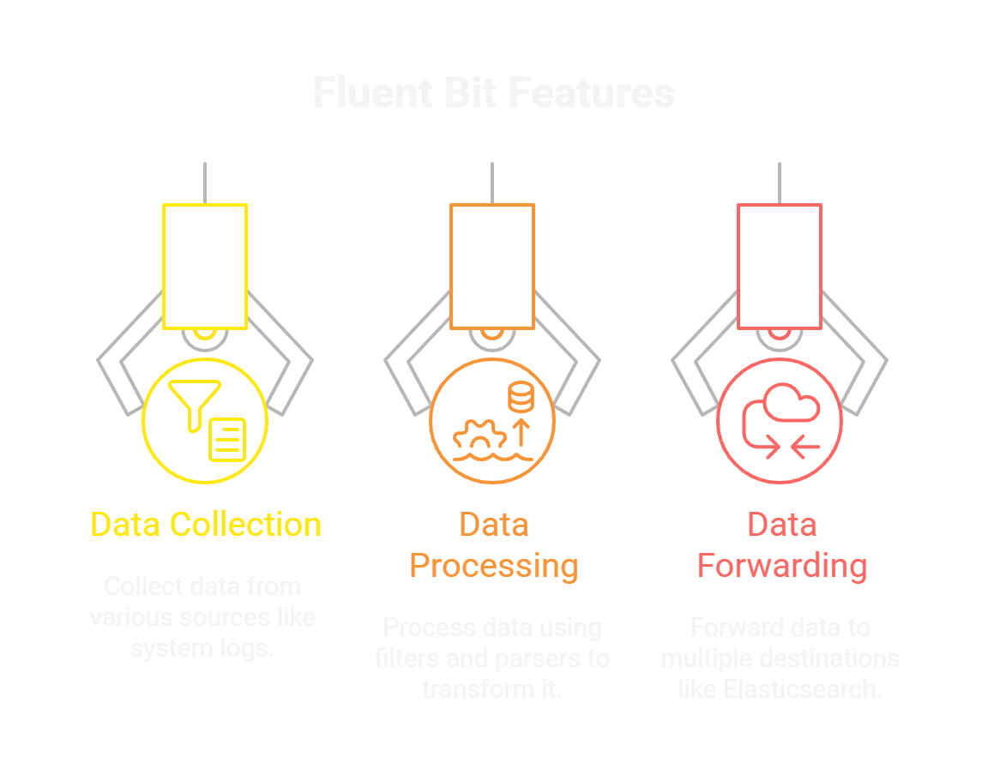
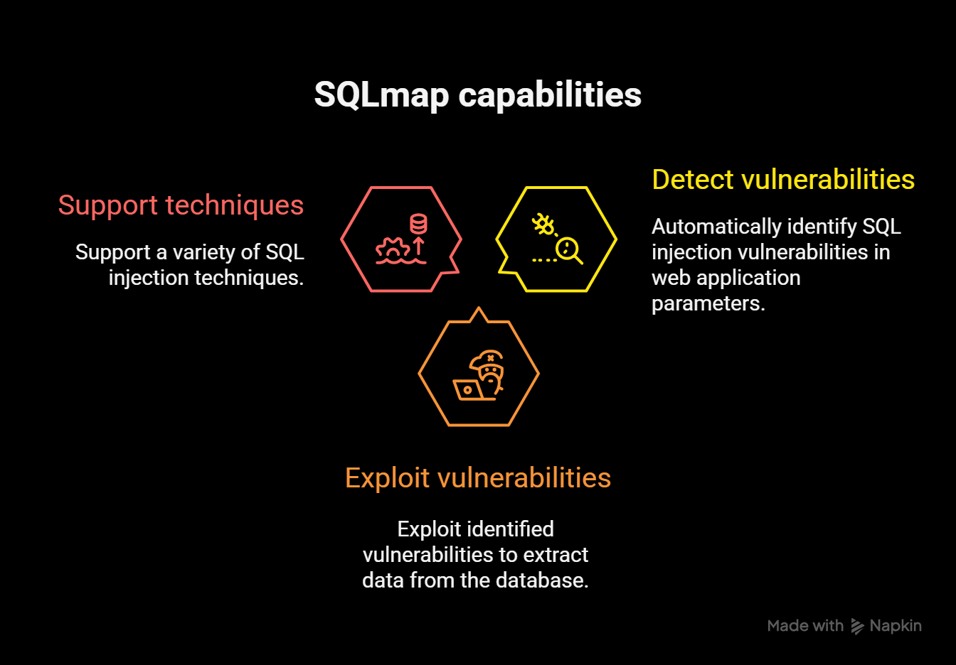
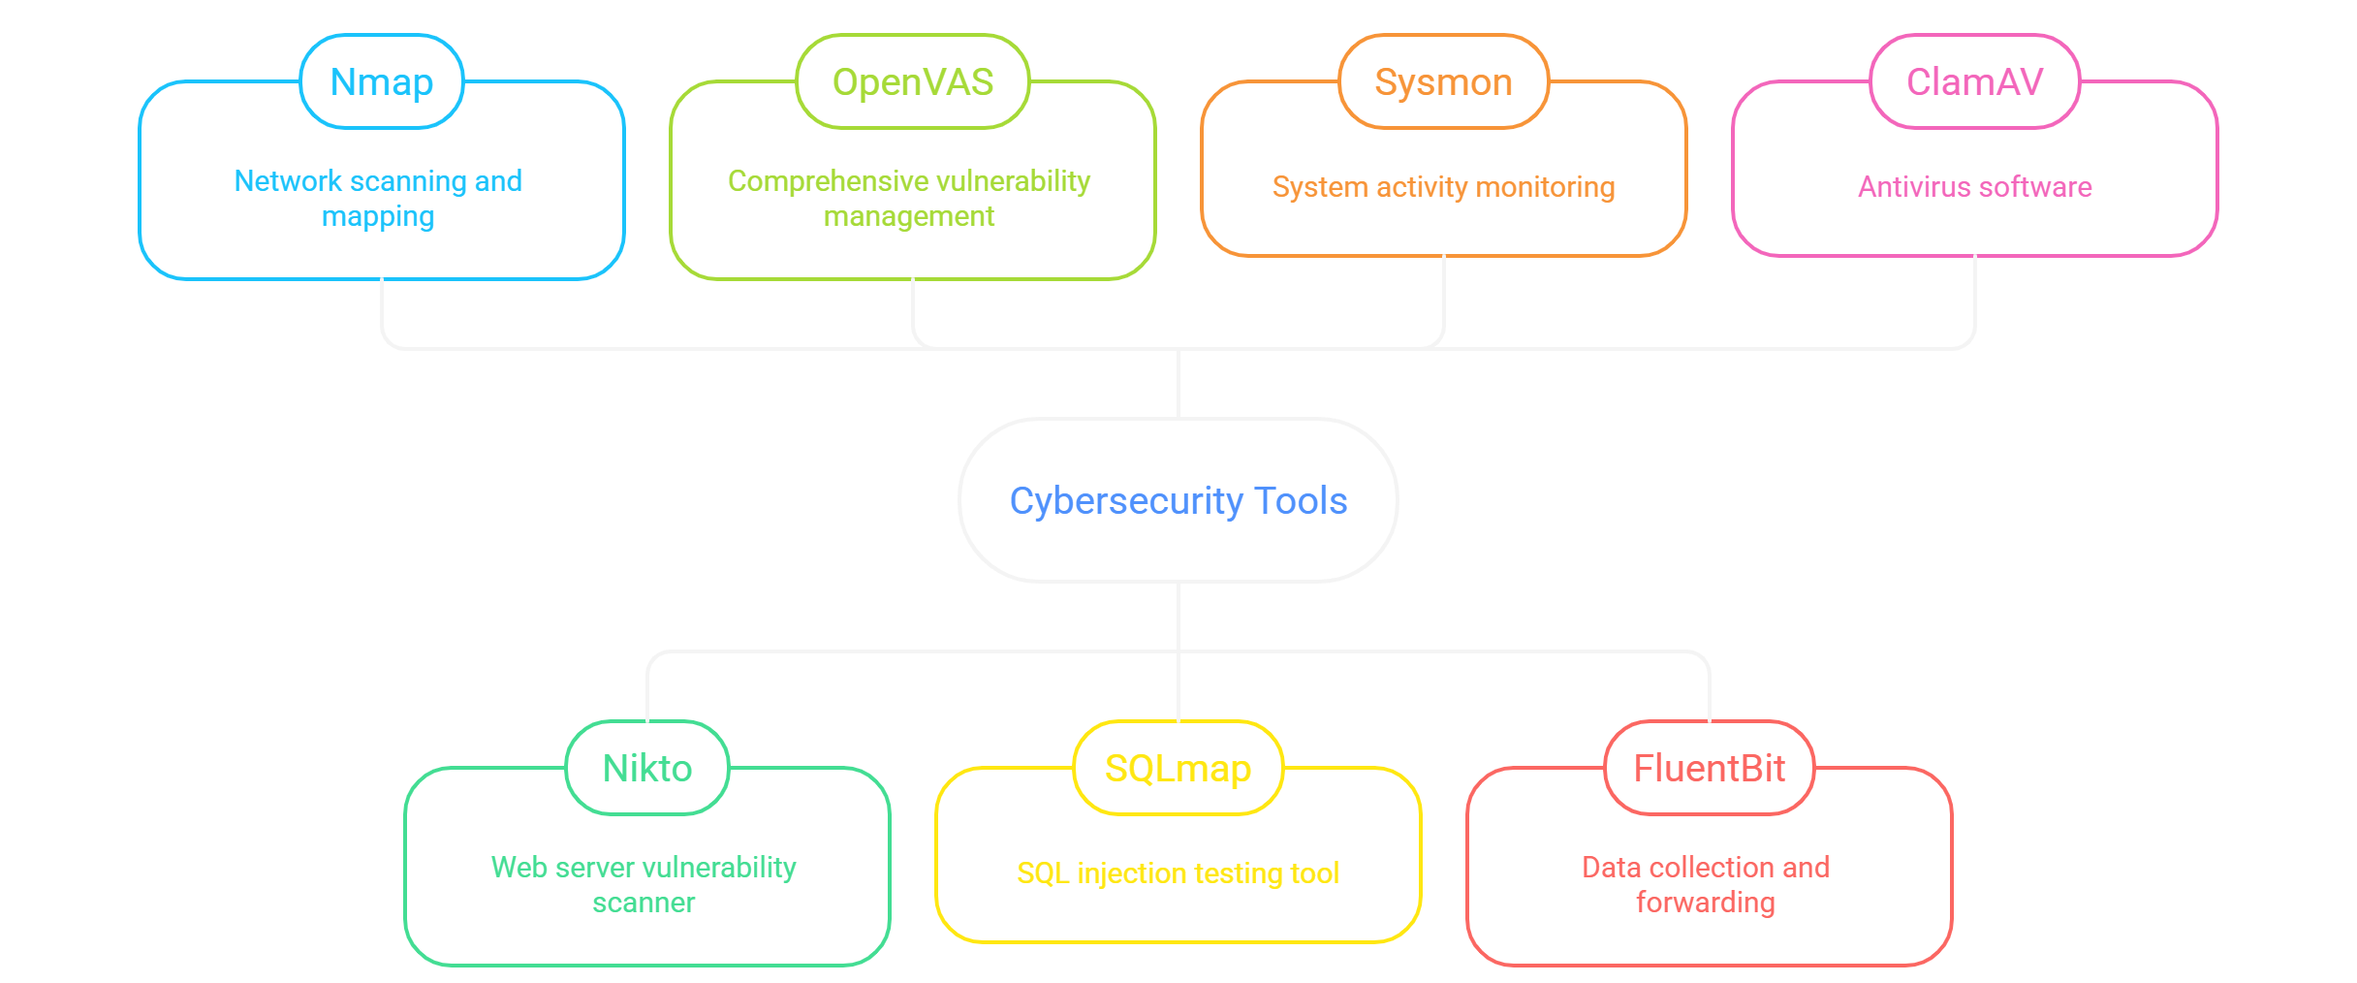
Initial Tools TDARE Using
19/10
Nikto features

Slide 45
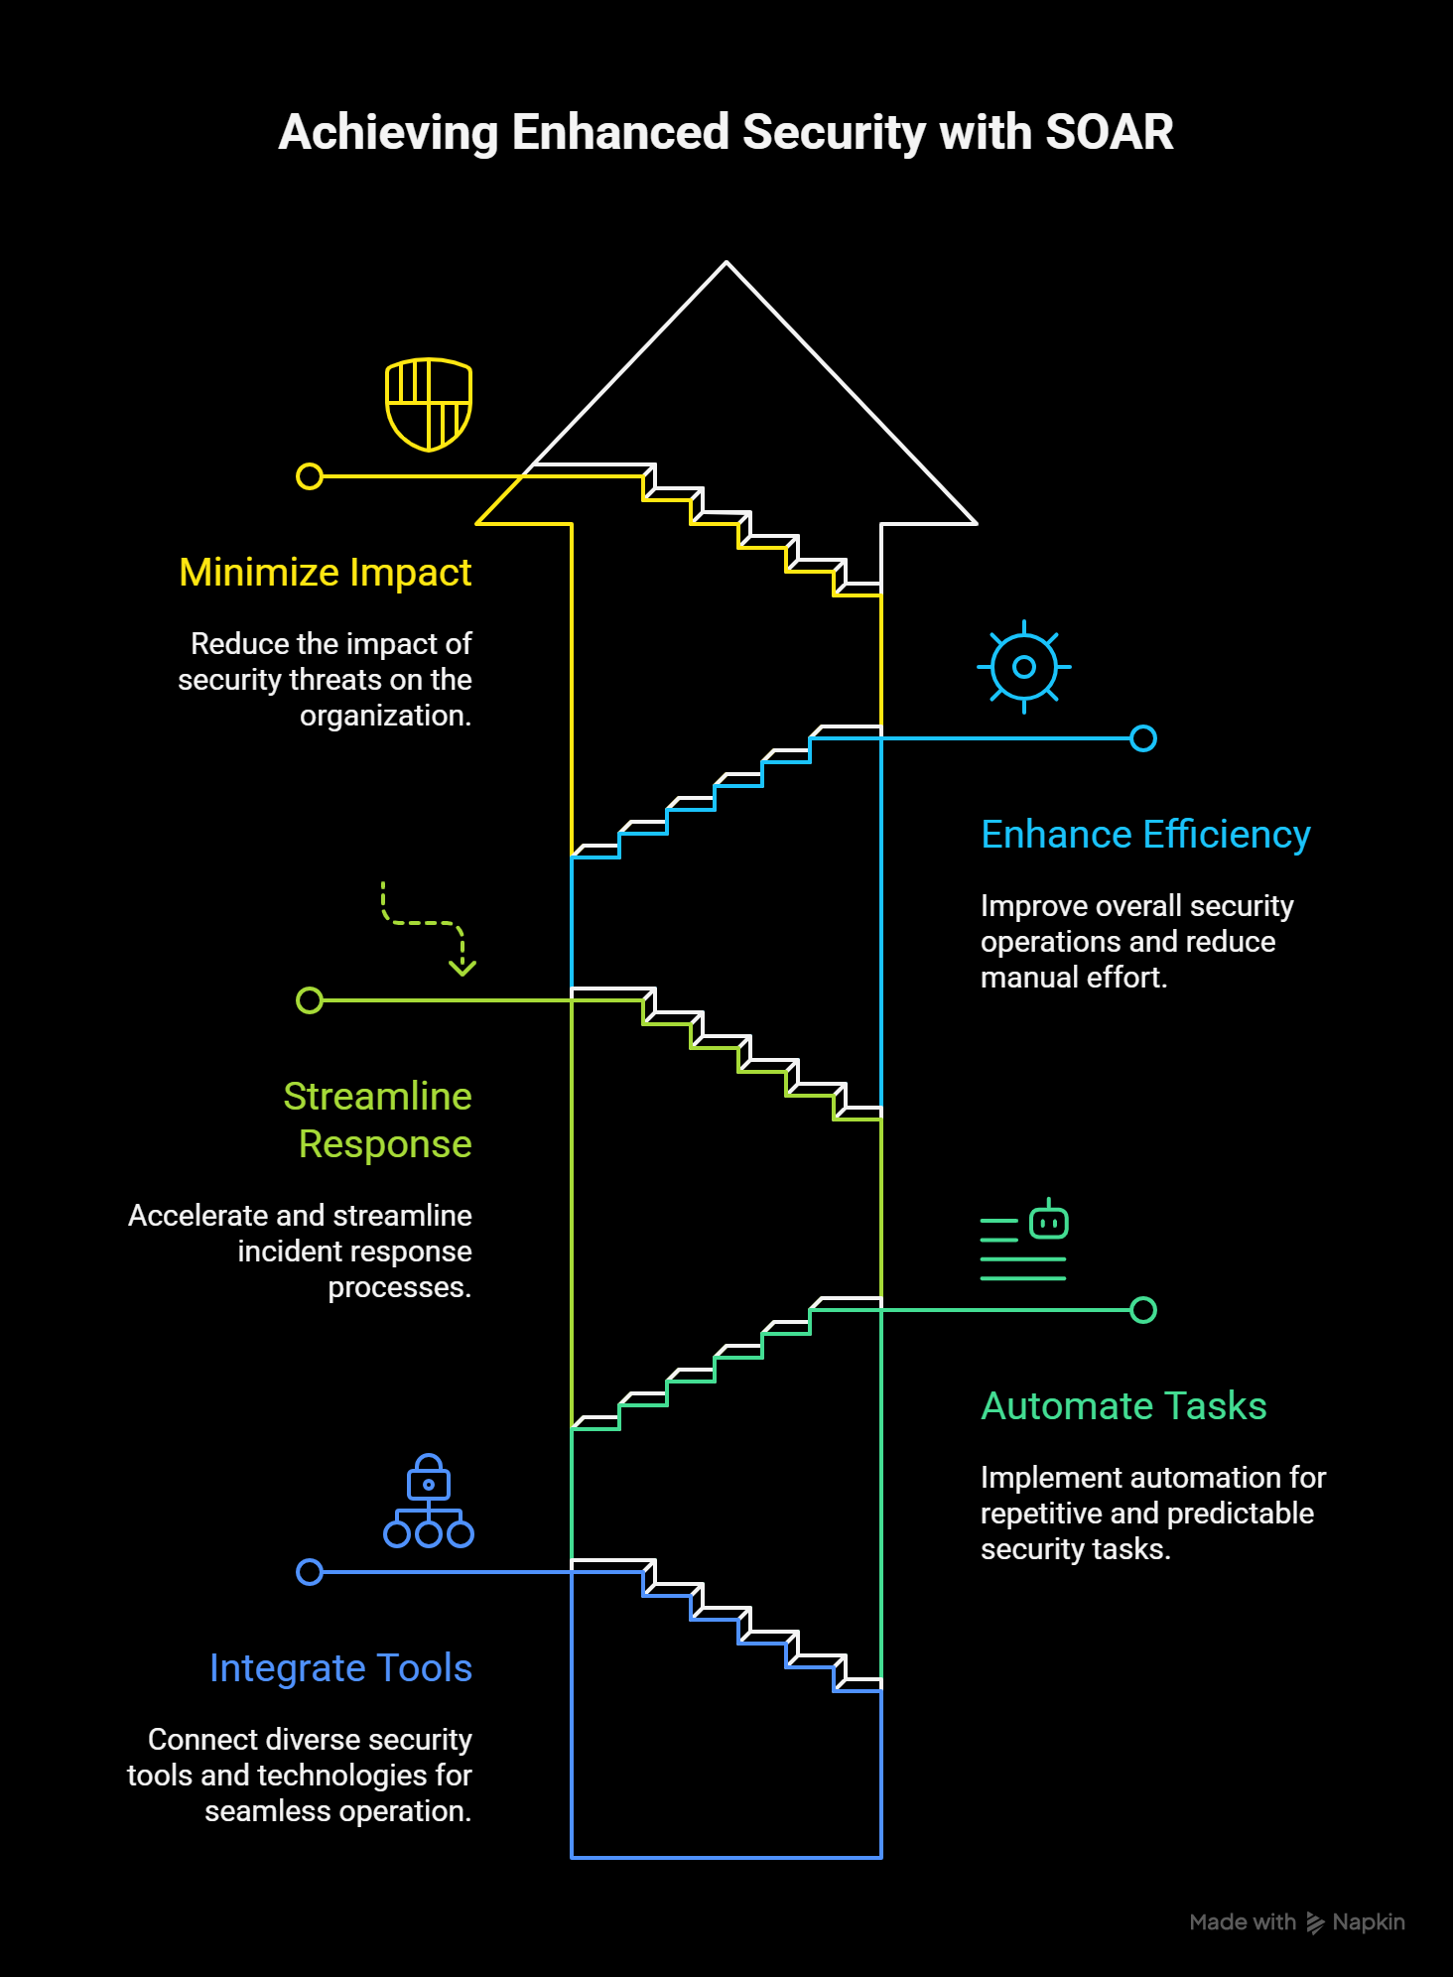
19/10
New-NetFirewallRule -DisplayName "OpenSSH Port 22" -Direction Inbound -Protocol TCP -LocalPort 22 -Action Allow

Slide 46
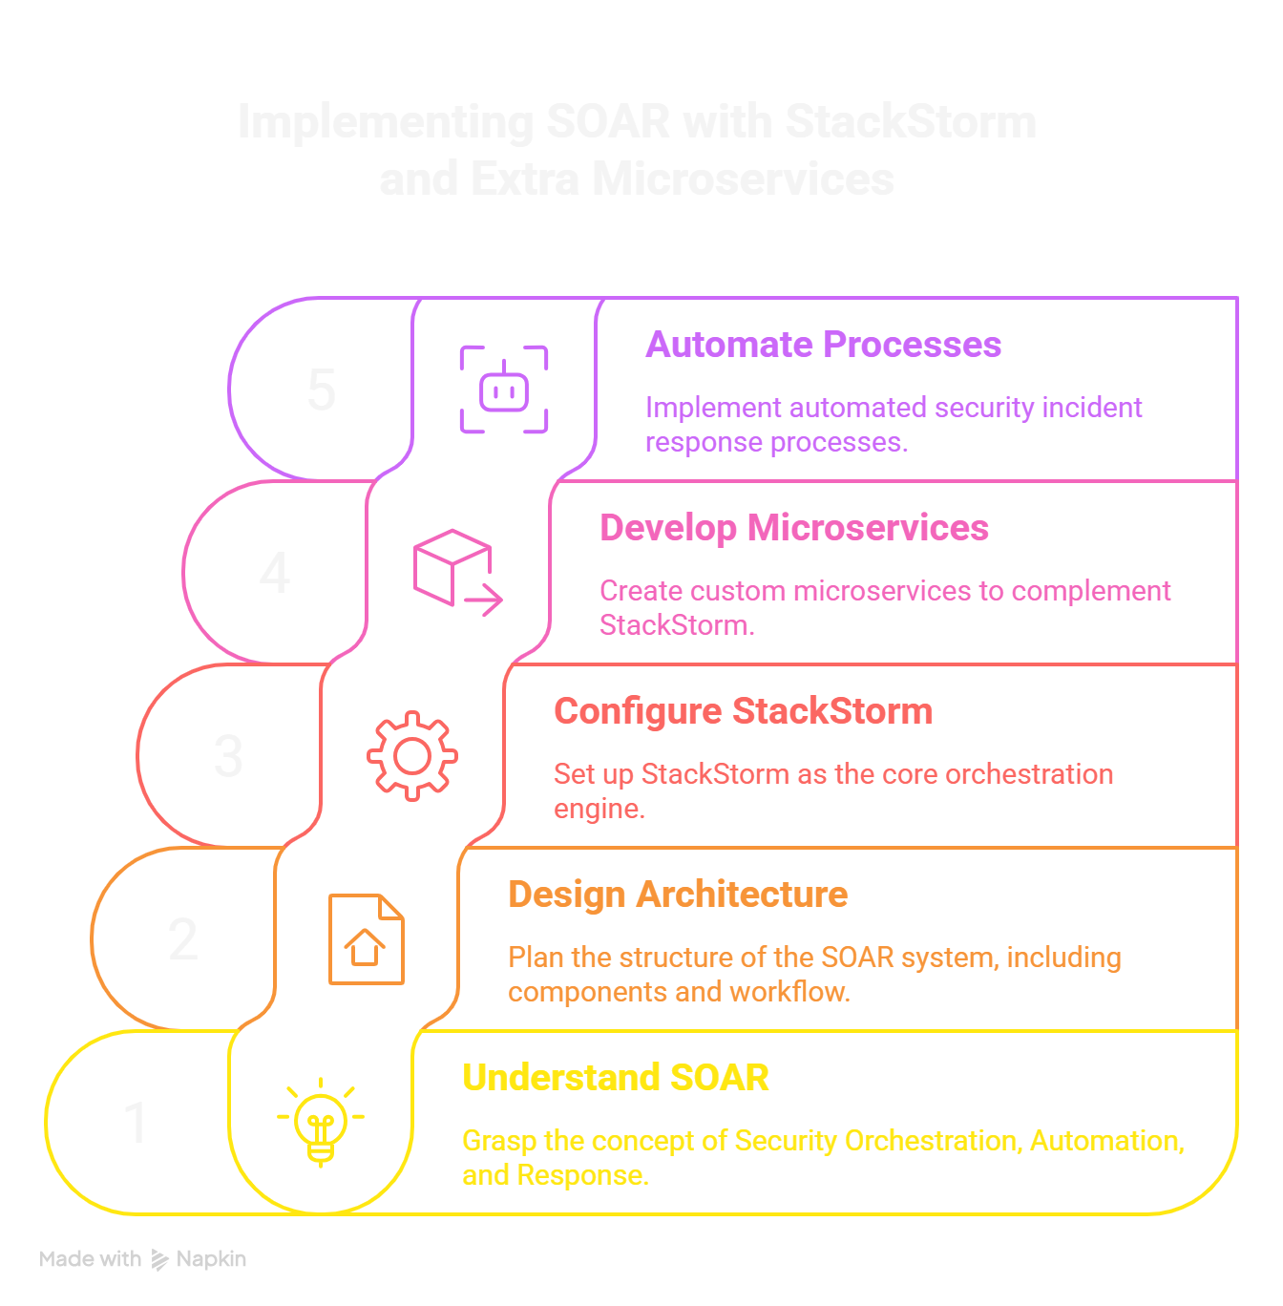
19/10

Slide 47
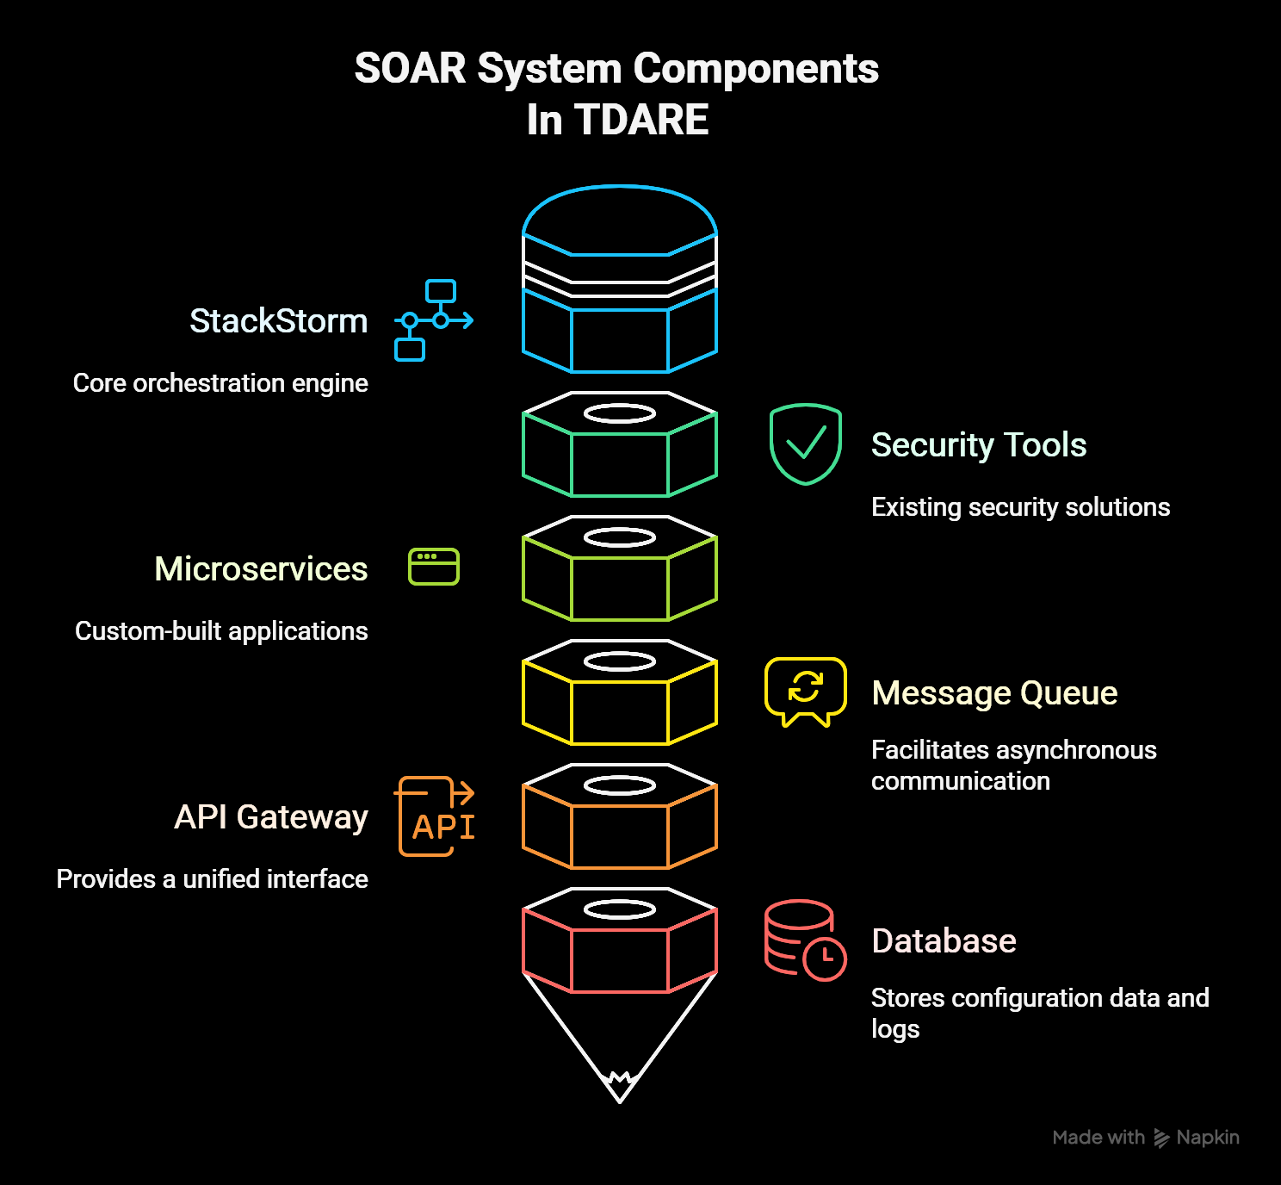
19/10

Slide 48
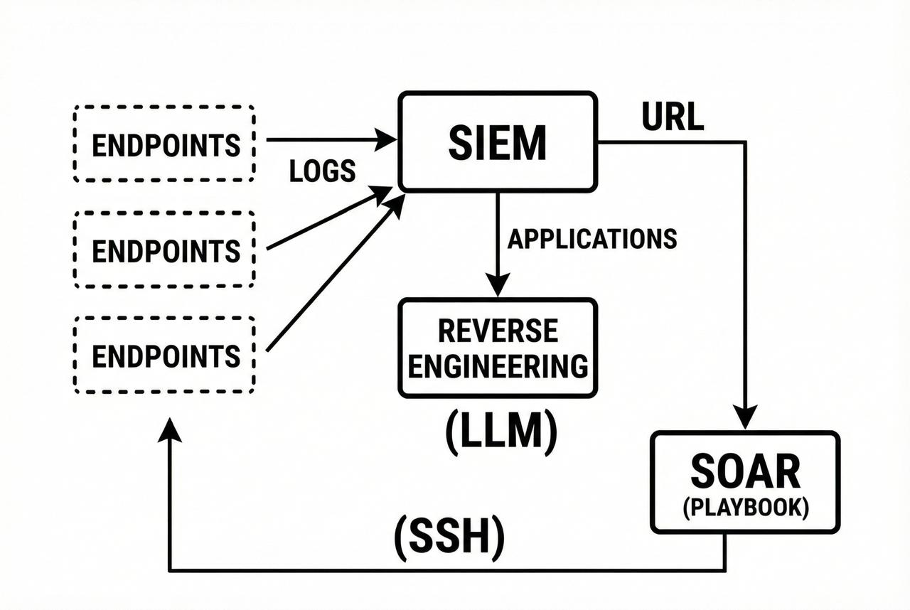

Slide 49
08/10
References
Penetration Testing for Startups & Small Businesses 2025
Why companies don’t invest in cybersecurity
How Do Cybersecurity Risks Differ Between Startups and Fortune 500 Companies
SOC analysts face alert overload, duplicate effort, survey finds
Ransomware WannaCry: All you need to know
Reactive vs. Proactive Cybersecurity: Which Strategy is Best? | Fortinet Blog
Artificial Intelligence (AI) Cybersecurity | IBM
Hiscox Cyber Readiness Report 2024 | Hiscox Group
IBM Report2024-2025
Malware detection and analysis tools
Analysis for malicious code reverse engineering

Slide 50
10/10
Thank you
We will be very happy to hear questions !
TDARE – everything is on the radar

